Slide 1
Breakthrough ACTION - Contraception Discontinuation
Human-Centered Design Capacity Strengthening Two-Day Workshop for the Testing Teams Day One
For the attention of the core design team leading this activity March 2023

Slide 2
Today’s Agenda
DayONE
Welcome and Background
1. Introductions of Participants and Workshop
2. Introduction to Human-Centered Design
3. Introduction to Prototyping and Testing
4. Practicing the Testing Process
Who is in the room? What is the mindset of this workshop? What happened before today?
What is human-centered design?
What is the mindset behind this approach?
What are the steps of the human-centered design process?
What are its advantages?
How does prototyping and testing work? What is a prototype? Why do we prototype ideas?
What is testing? Why is it useful?
How is testing conducted? What are the testing recommendations?
Rapid activity: Discuss three simulations.
Activity: Try rapid prototyping and testing in small groups.

Slide 3
Tomorrow’s Agenda
Day TWO
1. Feedback from Rapid Testing
2. HCD Testing Tips and Tricks
3. Reviewing Prototypes and Learning by Doing
4. Next Steps
What did you learn from this experience?
How can you use these learnings in the field?
What are the roles within the research group?
What tools and documentation need to be captured?
Review the testing documents and the six prototypes.
Tailor questions to suit your community’s needs.
Activity: Role play in small groups to try out the testing documents.
What comes after testing? What is next in the process?

Slide 4
Welcome
Foreword
Activity Context
This presentation aims at strengthening the capacity of social and behavior change (SBC) and family planning (FP) practitioners to test six solutions addressing contraception discontinuation. These solutions, or prototypes, are meant to be adapted for local use. Tested once in the Philippines, the prototypes should be tested again before adapting them to the needs of FP providers and women in need of contraception in your country.
Breakthrough ACTION is an eight-year cooperative agreement at the origin of this activity. It is funded by the U.S. Agency for International Development (USAID) to lead their SBC programming around the world. Breakthrough ACTION aims to encourage people to adopt healthier behaviors and enable positive social norms through improved SBC programming. Breakthrough ACTION is a partnership led by the Johns Hopkins Center for Communication Programs in collaboration with Save the Children, ThinkPlace, ideas42, Camber Collective, International Center for Research on Women, and Viamo.
Simple, experimental model of a proposed solution used to test or validate the design, ideas, assumptions, and other aspects of its conceptualization quickly and cheaply so that the designers involved can refine or change it according to user feedback.
Note: Think of a prototype as a prop allowing others to experience your idea by transforming an abstract concept into a meaningful product or service.
Prototype noun

Slide 5
Background
Previous Steps
In August 2021, the Breakthrough ACTION team embarked on a Discovery Research Phase in three locations in the Philippines to uncover insights behind contraception discontinuation. The team conducted in-depth interviews with 60 individuals, including discontinuers, partners, peers, healthcare providers, municipal officers, and community influencers.
The team then used these findings to ideate and develop ten prototypes to test in the field with users in June 2022. In this design and test phase, we met with 84 individuals, including discontinuers, users, partners, peers, and healthcare providers to test these user-centered solutions tackling the behaviour of contraception discontinuation.
Based on feedback from the user test sessions, the ten prototypes were redesigned and developed into a testing toolkit comprising six prototypes.
SBC practitioners in the family planning space can use this testing toolkit to adapt the prototypes for use in their communities.
Focusing question for this activity:
How might we understand women’s contraceptive journey and improve the approach of health care providers to lower rates of discontinuation?
A significant shift in perspective that helps to uncover novel opportunities. Insight connects information and inspiration in new ways to re-perceive a situation in a way that leads to an opportunity for action.
Insight noun

Slide 6
1
Introductions of Participants and Workshop

Slide 7
Participants
Warm-Up Activity to Get to Know Each Other
1) Who is in the room?
2) What are your expectations?
One by one, please share out loud, in a few words:
Who are you (name, role)?
What is your superpower?
Then, please throw the ball to the next person.
Take a few sticky notes and write down your expectations for this testing phase, to be shared with the group. Remember:
Include one idea per sticky note (key words).
There are no wrong answers.
There is no maximum number.

Slide 8
Workshop
Objectives
This workshop is meant to build the capacity of the team who will test the six prototypes designed against contraception discontinuation.
Day One
By the end of the day one, participants should have achieved these main goals:
Understand the HCD approach and mindset.
Learn about the HCD user-testing process.
Practice testing with one another to learn by doing and train for the upcoming test.
Day Two
By the end of the day two, participants should have achieved these main goals:
Familiarize themselves with the testing toolkit and six prototypes.
Adapt questionnaires and tools for the test target audiences.
Role play and practice test the six prototypes with one another.

Slide 9
Workshop
Mindset
1
Generate curiosity
2
Implement tools and ideas
Create awareness and knowledge of the human-centered design process, focusing on how design drives lasting innovations.
Practical tools and ideas help users experience design methods. Know the importance of empathizing with users and understanding people's needs.
3
Learn by doing
4
Challenge assumptions
Appreciate the value of learning by doing. Transform abstract ideas into tangible solutions, step by step, thanks to what we learn from users.
The goal of adopting a human-centered design mindset is to not act as experts and instead let the users provide their expertise.

Slide 10
Workshop
Origins
Intent statement summary
Phase one: Define In 2021, Breakthrough ACTION embarked on a project in conjunction with USAID ReachHealth Philippines and with support from ThinkPlace, Breakthrough ACTION’s global human-centered design expert, to examine and design human-centered solutions to reduce rates of contraceptive discontinuation in the Philippines.
An initial “define” phase started with a workshop where key stakeholders defined clear objectives in a one-page intent statement.
Central question
How might we understand women’s contraceptive journey and improve the approach of healthcare providers (HCPs) to lower discontinuation rates?
Strategic shifts
From | > | To
Assumptions of women’s reproductive journeys (e.g., transition points, circle of influence in their decision-making around contraceptive usage) | > | Becoming aware of women’s individual reproductive journeys as a whole (e.g., views, biases, barriers, and circle of influence)
Assumptions on the views and barriers of partners, family, and immediate community around contraceptive usage | > | Identifying potential barriers and areas for intervention within the family (including partner) and community
Spoon-feeding mentality, which prevents clients from thinking for themselves | > | Creating equal and sustainable partnerships with clients
Lack of knowledge around relationship dynamics and inconsistencies in client relationships | > | Identifying potential areas for improving interpersonal trust, communication, and HCP channels of support and assistance
Activity phases
Phase one: DEFINE (2021)
Set goals and qualitative research to understand user perspectives
Phase two: DESIGN & TEST (2022)
Conduct iterative prototyping and testing based on phase one insights
Phase three: APPLY (2023)
Implement, evaluate, and refine solutions

Slide 11
Workshop
Origins
INSIGHTS: Contraception users’ relationship with FP
Design questions
STRUCTURAL CONSTRAINTS Access to medical services, FP commodities, and trained professionals is not consistent across health sectors or regions. | How might we … … provide consistently good service and supplies across health areas?
RELIABLE INFORMATION Users do not always receive reliable and accurate FP information from their current sources. | … ensure the dissemination of accurate and consistent FP information to existing and potential users?
TRUSTED CHANNELS Users do not have a consistent relationship with HCPs. They turn to info networks for ad-hoc advice and help when FP challenges arise. | … generate trust and confidence in HCPs?
SUPPORT CHANNELS Users do not have a consistent guide or companion on their FP journey. They base FP decisions on situational judgement and on what and who they know. | … build a more consistent client-HCP relationship so that HCPs are the preferred resource for FP matters?
1
2
Following the intent statement activity, the team developed lines of inquiry guiding the field research in search for new insights. This phase culminated in a deep dive into the main findings uncovered during fieldwork (i.e., themes and insights around users’ and related influencers’ attitudes, behaviors, and habits leading to discontinuation of contraception).
3
4
INSIGHTS: Healthcare providers’ challenges
Design questions
STRUCTURAL CONSTRAINTS HCPs do not have sufficient time and energy to handle their assigned responsibilities due to ongoing resource shortages. | How might we … … improve the efficiency and adaptability of HCPs for FP to remain a pillar of health care services?
RESOURCES AND TRAINING HCPs want more training and medical capabilities to update their current skill sets. Health centers often lack structure for training and providing resources. | … strengthen exchange of knowledge between HCPs and build their confidence and motivation?
RELATIONSHIP BUILDING Barriers in relationships between HCPs and clients include inconsistent follow-ups, lack of trust and confidence, and increasing distance from younger users. | … reimagine the HCP-client relationship of the future, built on trust and confidence across various cohorts?
1
A significant shift in perspective that helps to uncover novel opportunities. Insight connects information and inspiration in new ways to re-perceive a situation in a way that leads to an opportunity for action.
Insight noun
2
3

Slide 12
Workshop
Origins
Phase two: Design & test After creating ideas with key stakeholders, Thinkplace transformed these ideas into ten user-centered and testable prototypes for reducing rates of contraceptive discontinuation.
The design experts facilitated a full-day human-centered design capacity-strengthening workshop in Manila with all test team members. Over five days, the test was conducted in each area to understand how the prototypes would evolve in reality, in the hands of HCPs, clients, peers, and influencers.
Summary of testing round #1 Ten prototypes were tested.
Republic of the Philippines
84
contraception users, peers, partners, and HCPs (in total) tested the ten prototypes and were interviewed.
Camarines Sur, Luzon
Each field testing team included
One ReachHealth local lead
One ThinkPlace designer
Two ReachHealth or Philippine Commission on Population support staff
Cebu, Visayas
3
Regions where the ten prototypes were tested:
Visayas (rural area)
Luzon (urban area)
Zamboanga (peri-urban and rural area)
Zamboanga City, Mindanao

Slide 13
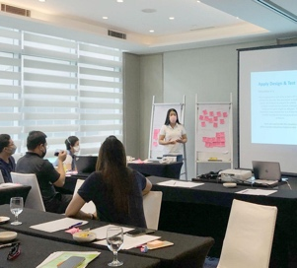
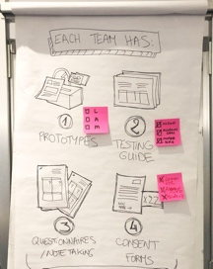
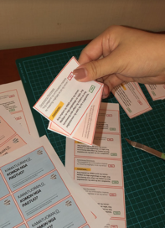
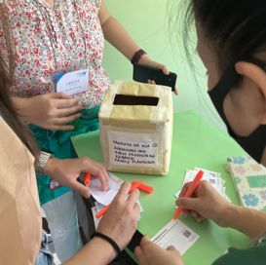
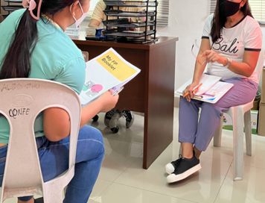
Workshop
Origins
From test results to this testing toolkit
After progressively assessing each prototype’s desirability, viability, and feasibility in two to three rounds of testing, prototypes were discarded, added, or improved after each analysis, according to user feedback and activity objectives.
Following a thorough classification and visualization of data, as well as the use of human-centered design analysis tools (e.g., user journey map below), six prototypes emerged from the analysis of the first round of test for further testing.
Capacity strengthening workshop, prototyping, and testing with identified users in the Philippines

Slide 14
2
Introduction to Human-Centered Design (HCD)

Slide 15
Introduction to HCD
What is HCD?
Human-centered design is a mindset with specific method and tools used to understand users deeply in their own context and from their own perspective.

Slide 16
Introduction to Human-Centered Design
Approach to HCD
HCD considers people as the experts of their own needs.
From my perspective
Assumptions
Doubts
Ideas disconnected from reality
“I think …”
“I’ve read …”
“I’ve heard …”
From the user perspective
Certainties
Facts
Ideas aligned with reality
“I know …”
“I’ve observed …”
“I’ve experienced …”

Slide 17
Introduction to HCD
HCD Method
Deep understanding of users helps to uncover insights and unspoken needs, motivations, behaviors, influences, and challenges of the target audiences. The goal of HCD is to include users in the development of solutions by using visual language and creativity, which all humans possess to a certain degree.
HCD also prioritizes the most critical needs or barriers from a variety of stakeholders’ perspectives to design an intervention with a high chance of being adopted, accepted, and maintained by all key actors within the system.
DESIRABILITY
(user’s needs & motivations)
ADOPTABILITY
(impact & durability)
HCD
VIABILITY
(scalability & resources)

Slide 18
Introduction to HCD
HCD Method
Human-centered design experts and / or Core Design team who synthesize the other voices to inform and build the interventions
To carry the expertise of key stakeholders (especially the one of users), while ensuring the activity objectives, Human-centered designers balance all relevant “voices of design”.
Voice of Intent
Views on what is desirable for society, from government, and the donor organisation
Voice of Design
The Four Voices of Design
Voice of Experience
Knowledge about context, what might be possible and what will be viable from experts on the subject.
Views on what is desirable from the user, clients, and service providers
Voice of Expertise

Slide 19
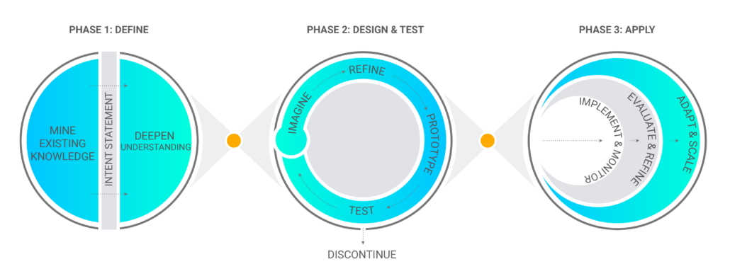
Introduction to HCD
HCD Process and Steps
We are here

Slide 20
Introduction to HCD
HCD Process and Steps
Uncertainty
Patterns, insights
Attempts
Clarity, focus
Phase one: Define
Phase two: Design & test
Phase three: Apply
Reference: The Design Squiggle (Damien Newman)

Slide 21
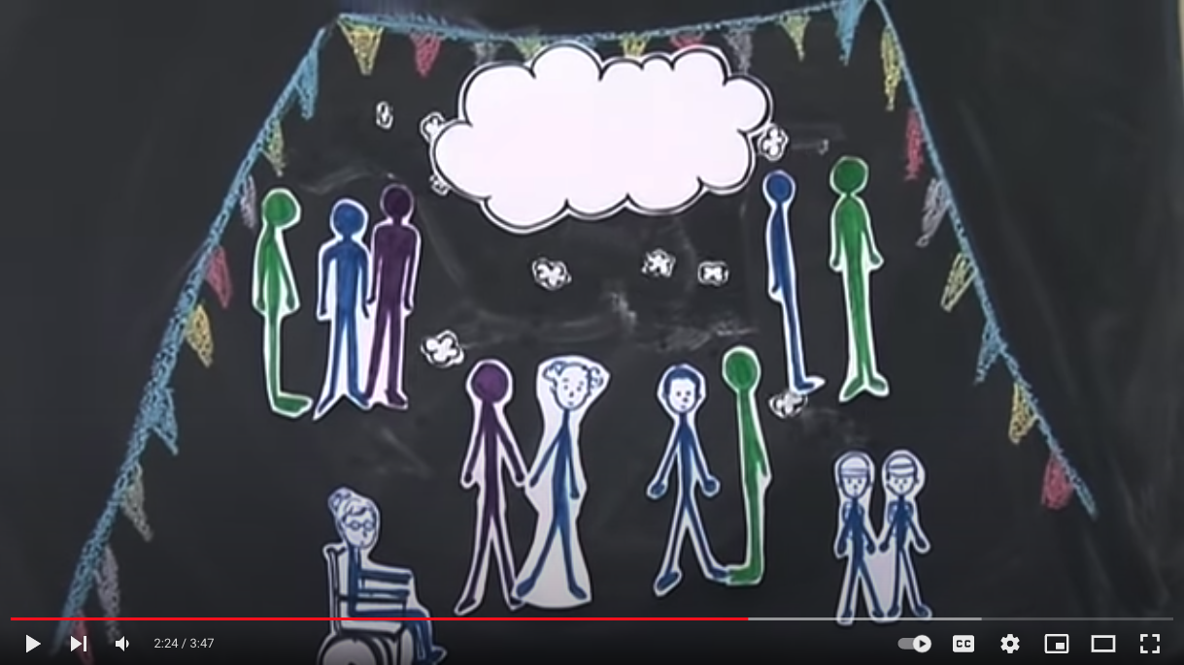
Introduction to HCD
HCD Example
Go to video

Slide 22
Introduction to HCD
HCD Advantages
1
Works in many contexts
4
Empowers users of the system, product, or service
HCD focuses on a common denominator: the people or “users” at the center of a problem.
Because HCD is inherently user-centric, it provides a voice to people involved in an issue who might otherwise be overlooked or underrepresented.
2
Has flexibility
HCD can be used to help us determine the layout of an office and to develop policy at the national level. Regardless of the size of the design challenge, the process remains the same.
5
Produces results valued by and tailored to the target audience
The iterative nature of HCD allows continuous collection of feedback and development of ideas in collaboration with users. This process results in results that closely match user requirements.
3
Works for complex systems
Design challenges are often complex in nature and fit into larger systems; because of this, they are not easily fixable. HCD methodically works through complexity by exploring a problem extensively before converging on potential solutions.
Eliminates project risks through an iterative process to solution creation
6

Slide 23
3
Introduction to Prototyping and Testing

Slide 24
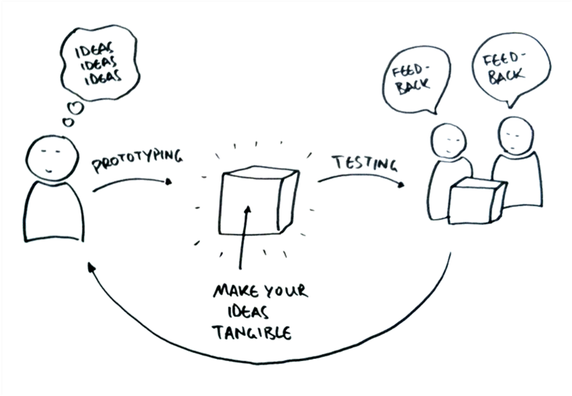
Prototyping and Testing
Prototyping and Testing: A Repetitive Process
Create. Make prototypes from ideas based on insights.
Validate. Test and seek feedback from users to evaluate prototype efficacy.
Analyze and adapt. Analyze test results and refine the prototype based on lessons learned.
Re-validate. Test and adapt again, according to HCD’s indicators of success. Do the prototypes create the desired results? Are they easy to use? Will people want to use them durably? Can they work in different contexts?

Slide 25
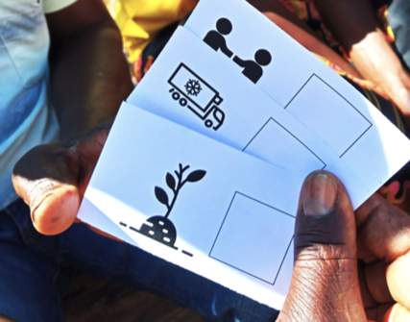
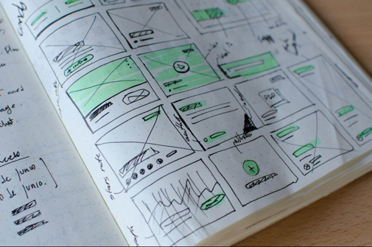
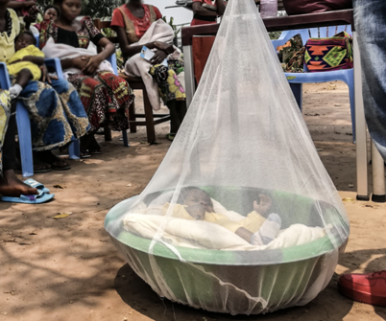
Prototyping
What is a Prototype?
A prototype is a product, service, draft, or similar way to try an idea and share it with an audience with minimum investment and the option to improve it several times. Typically, a prototype is used to evaluate a new solution and better understand that solution through end-user interaction, and modify it accordingly.
Prototypes are crucial to the design process and used in all design disciplines by product, service, and industrial designers, as well as engineers and architects, to test their ideas before investing in production.
Prototype examples from various projects

Slide 26
Activity
What Does a Prototype Look Like?
What shapes can a prototype take? Write them below.
The purpose of prototyping is to validate or invalidate an initial idea and to test assumptions in real conditions. An idea can be nice on paper but not work in real life. The goal is not to validate a detail but to focus on the core value proposition of the idea.

Slide 27
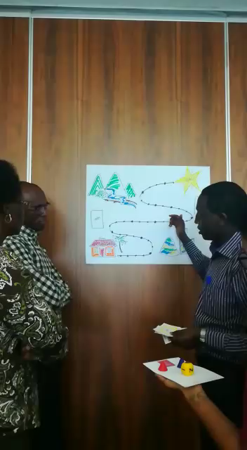
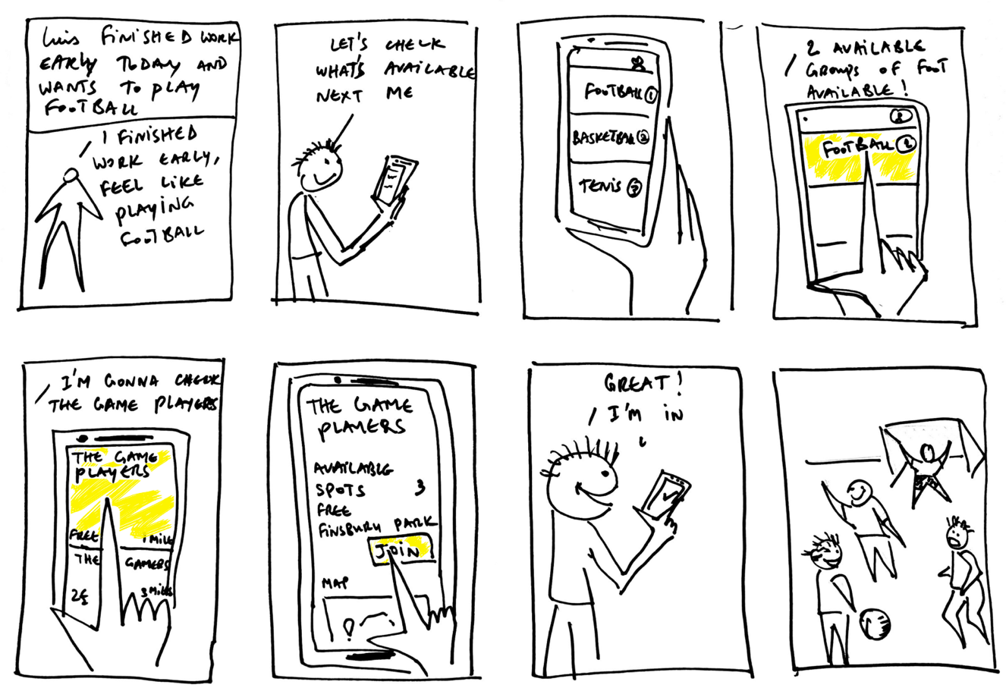
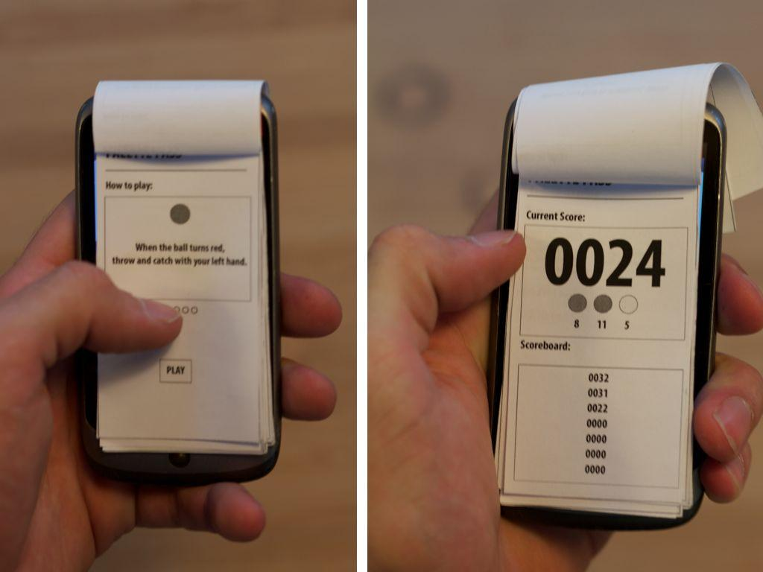
A Prototype can be …
… User-Interaction Sketches, Storyboards, and Mappings

Slide 28
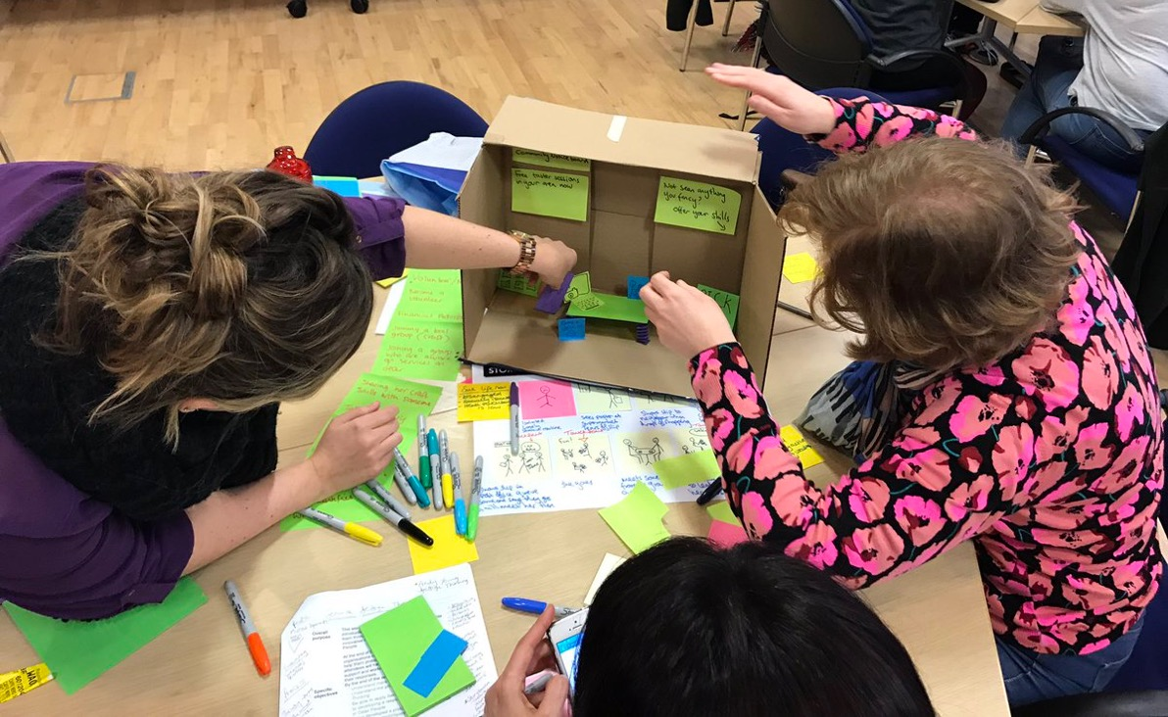
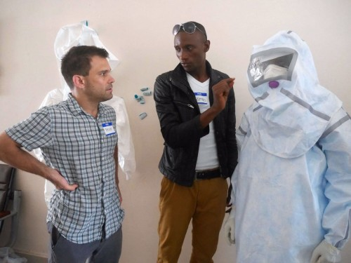
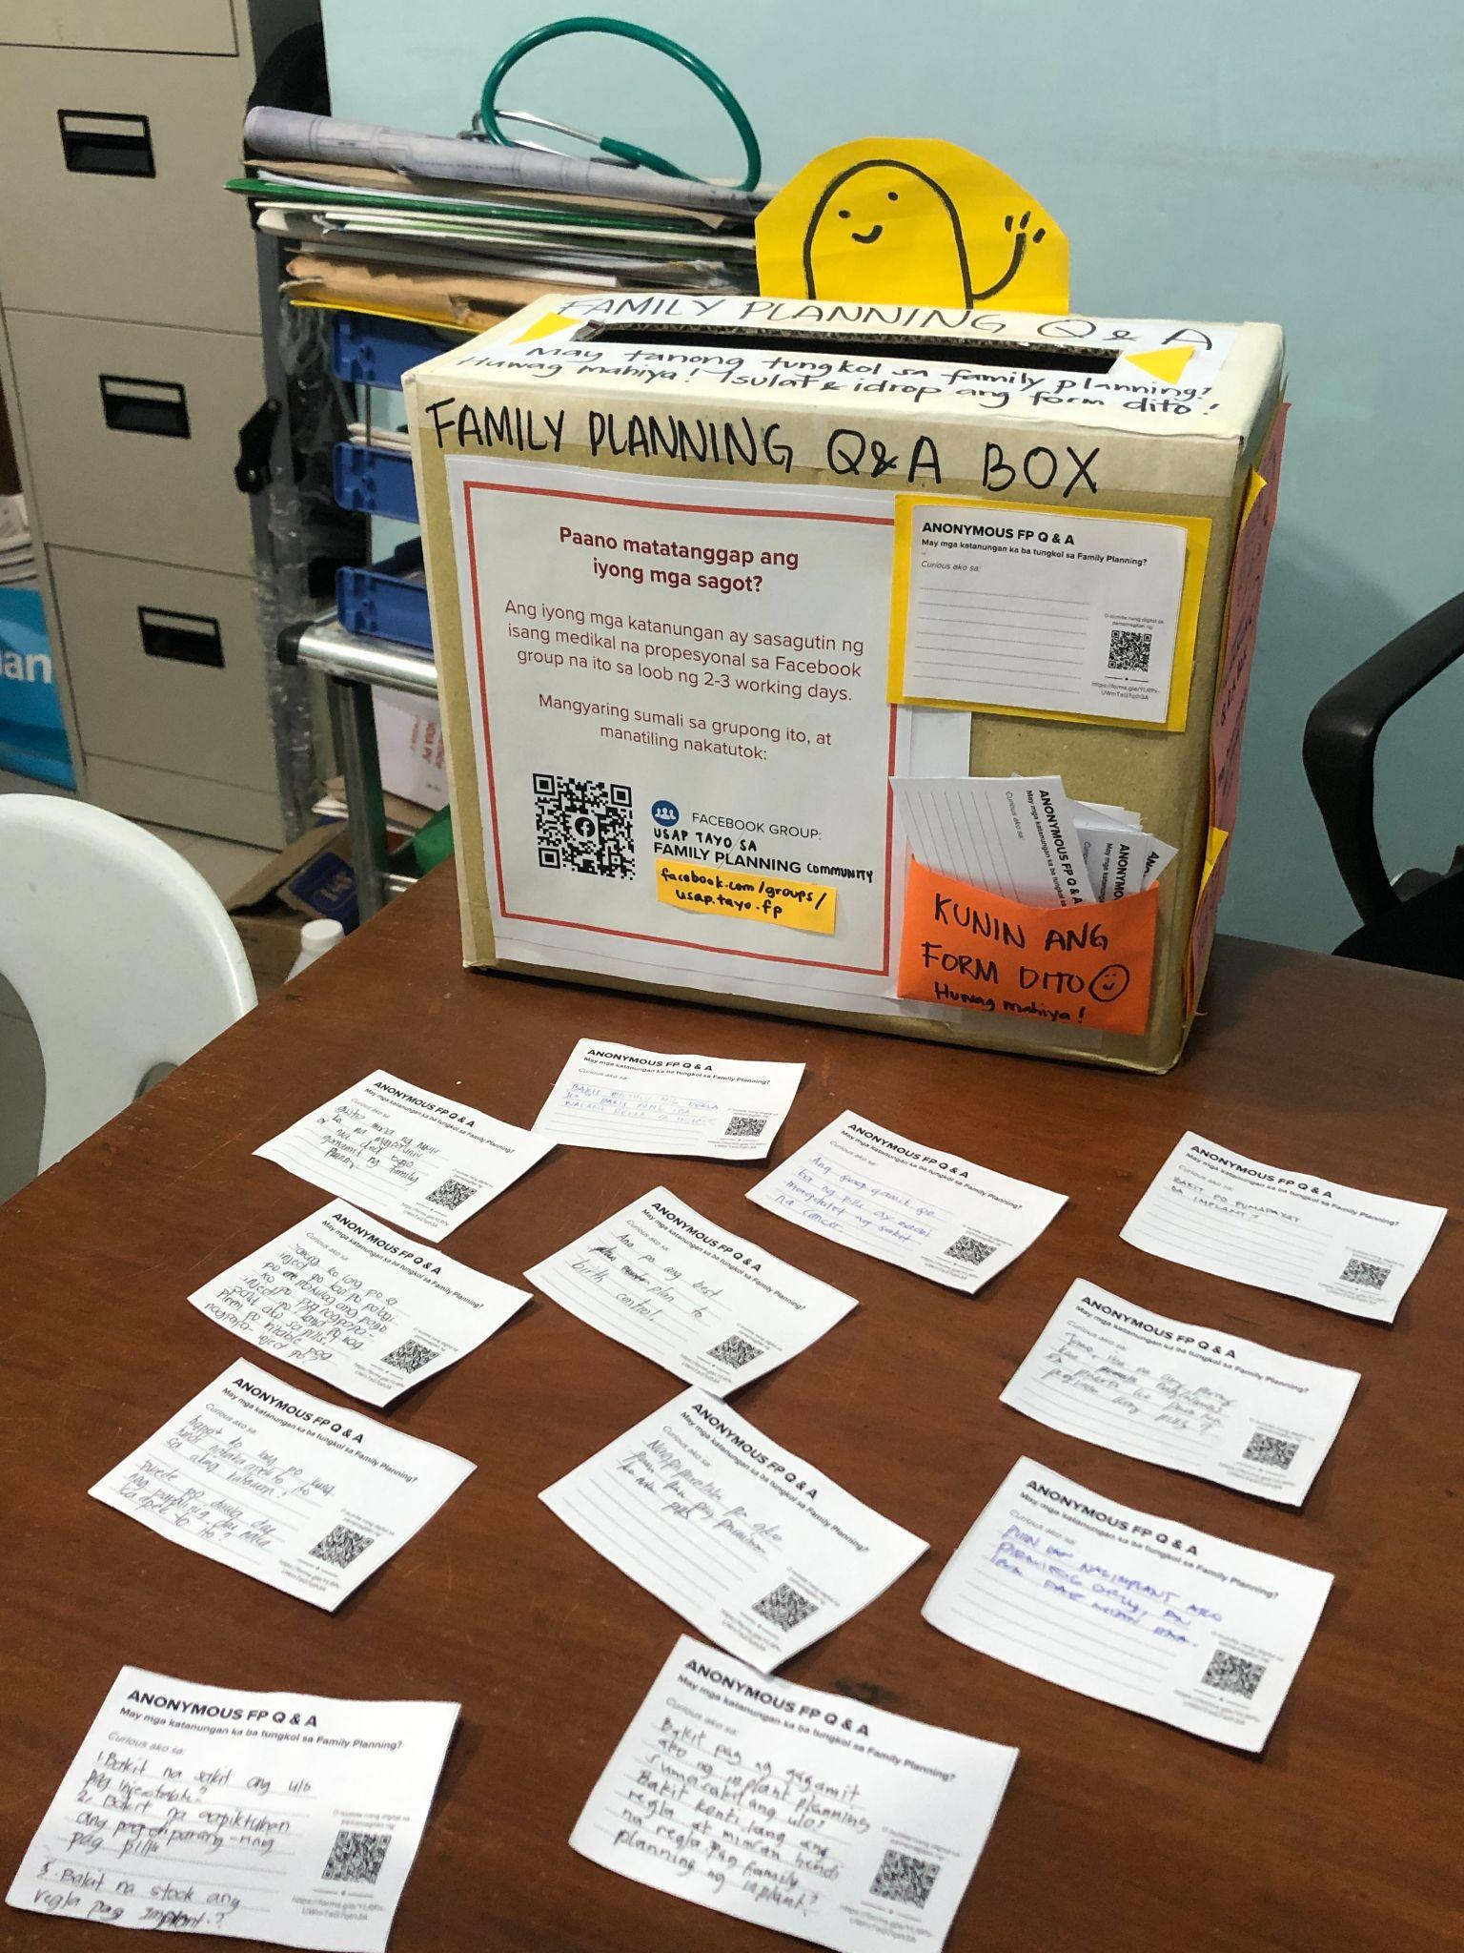
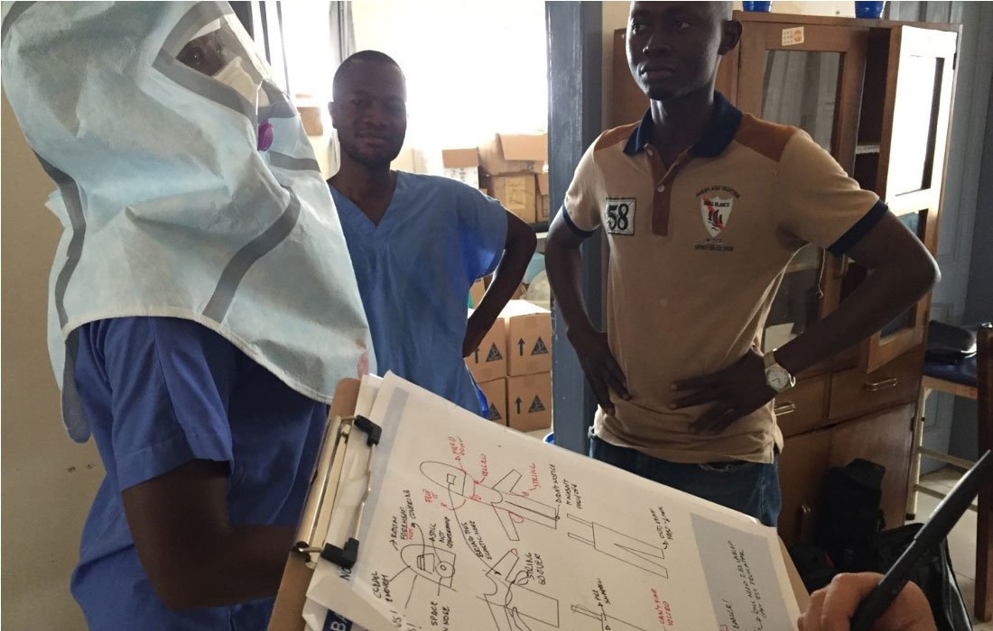
A Prototype can be …
… a Physical Model of an Object or Space

Slide 29
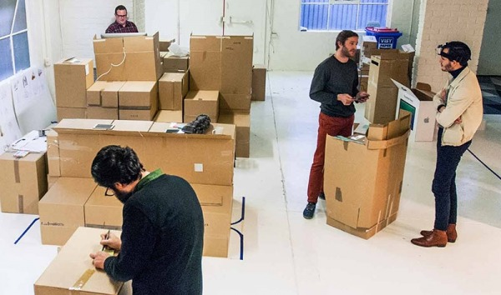
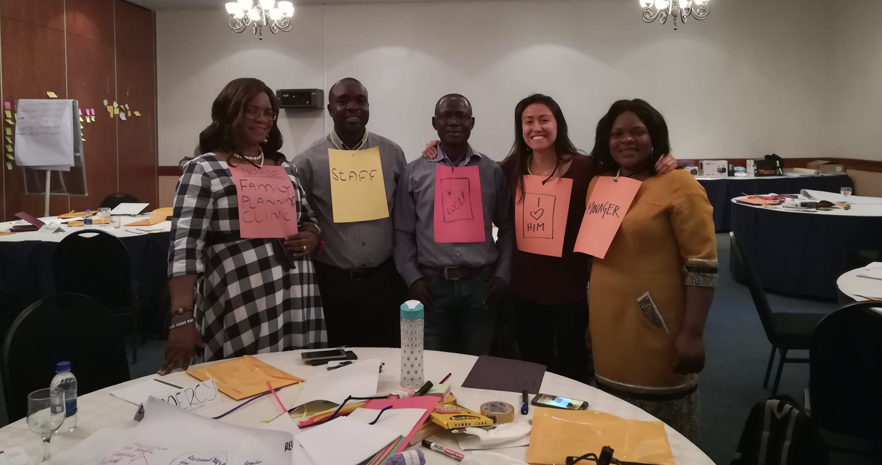
A Prototype can be …
A Role Play or Live Simulation
A role play prototype is fairly easy to build and can help get an idea, experience, or product in front of an audience quickly. It would be smart to test role-playing on the design team first. We can learn a lot by testing people's roles before we even leave the office.

Slide 30
Prototyping
How Prototypes Evolve Through Testing Rounds
Low Fidelity
Medium Fidelity
High Fidelity
The initial designs allow users to visualize the idea.
Designs are then validated and improved through testing.
Designs are nearly final in the last round of testing or piloting.

Slide 31
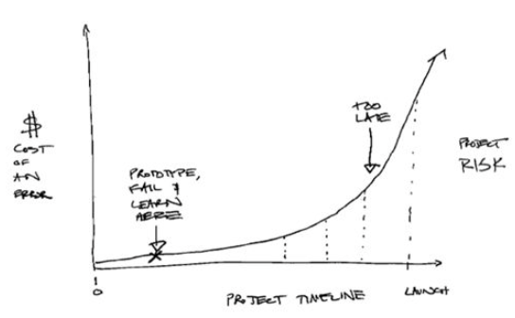
Prototype Testing
Why is Testing Useful?
Prototypes often “fail” when tested, which is a good thing. Failure reveals flaws so that the design team can refine or iterate on proposed solutions based on actual user feedback. We often learn much more from failures as they provide tangible feedback and help the design team understand users’ needs.
Prototypes that fail early can save a project by avoiding wasted energy, time, and money on solutions users would consider weak or irrelevant.

Slide 32
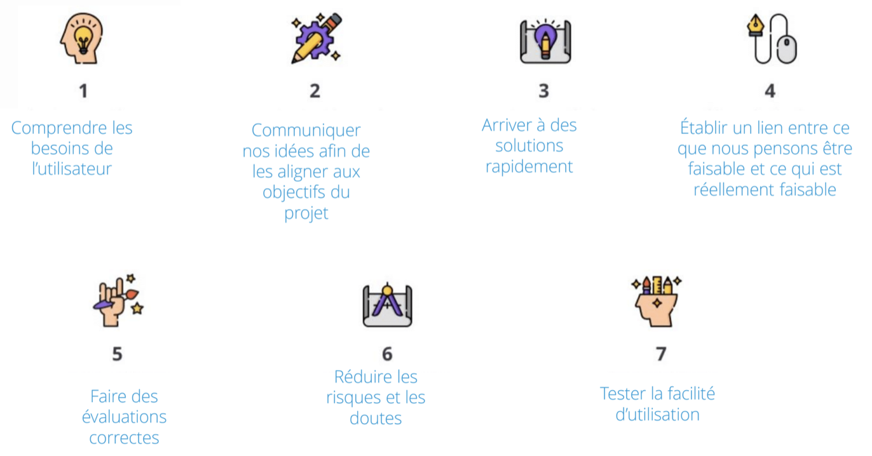
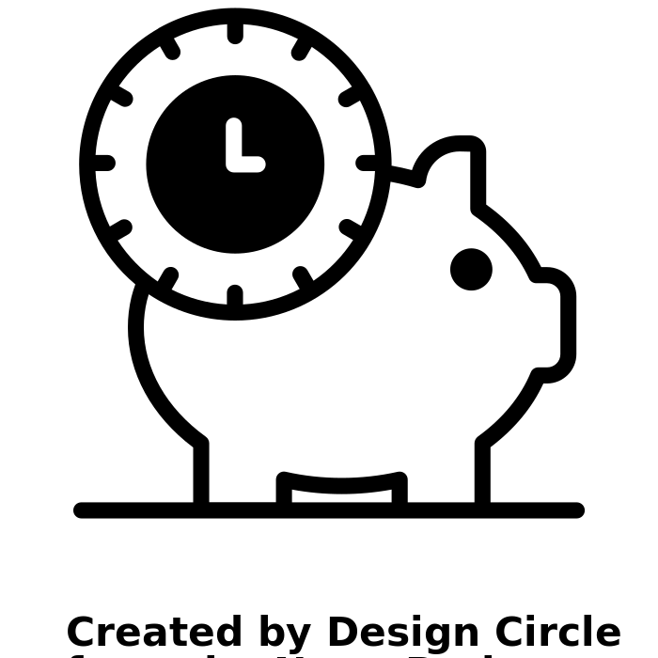
Prototype Testing
Testing Goals
Understand user needs
Communicate ideas to all in line with activity goals
Rapidly reach tangible solutions
Link what we imagine is feasible and what is actually feasible
Make correct assumptions
Reduce risks and doubts
Assess usability and desirability

Slide 33
Testing
Testing Teams
Prototypes to prevent contraception discontinuation benefit from testing with many audience types in diverse environments (rural and urban areas, areas with diverse religious beliefs). This approach may require several testing teams to test simultaneously in two to three places.
Contraceptive users
and discontinuers
Single and married women aged 18-45 years old, with or without children, and either within and not within the HCP network
Partners
Men over 18 years old who are boyfriends or husbands of users
HCPs
Providers who disseminate FP counseling and contraception, including pharmacists (if allowed to provide contraception freely)
Community leaders
Persons identified by clients and others in the community as influential and trusted, such as local and religious leaders (according to context)
Family members & peers
Non-partner influences such as mothers, sisters, mothers-in-law, and friends from whom users take advice

Slide 34
Testing
Testing Team Roles and Tasks
The testing team is in charge of leading testing activities with users, as described in the previous slide. Each testing team should have three to five members (too many persons can intimidate participants), including at least one member of the core design team.
In each team, assign the following tasks to ensure good coordination, communication, and recording of activities (each person may have several roles):
Must-haves for testing
Prototypes
Testing guide
Questions & notes
Device with camera
Team and participant coordinator
Timekeeper (holds the agenda)
Consent forms manager
Translator (if necessary)
Prototype & equipment supervisor
Notes & transcription manager
Communication & debrief supervisor
Photographer
Documents provided with the testing toolkit

Slide 35
Testing
Gathering Feedback
Prototypes are tested independently with a sample of users for whom they are designed.
Testing is usually conducted in two to four areas simultaneously. Each testing team should contact users and then plan its testing agenda. When testing at a health center, community center, or home, the testing team should ask the testing participants to use the prototype as they would in a regular context. Then, the team should gather user feedback via a specific questionnaire.
All documents can be found in the testing toolkit.
How do we collect feedback while testing?
Test each prototype with the right users.
Provide users with the activity context (who, what, why, how). Introduce the solution in a few words.
Ask focused or open questions according to the situation. Ask “why” to uncover motivations behind “yes”/”no” responses.
Be as neutral as possible when presenting the ideas. Do not influence users with your beliefs.
If more clarity is needed, slightly improve a prototype while testing.
Allow users to share their own ideas and to be enthusiastic about what the prototype could become.

Slide 36
Testing
Recommendations
Good practices during testing | Practices to avoid during testing
Ask participants to think aloud. For example, as they read content, ask them to describe their thoughts while they read it. | Avoid asking participants for their opinion in a direct and personal way. For example, avoid asking, "Do you like this prototype?" or "Do you think it's a good idea to create something like this?" The answers to these questions are not helpful as they are too subjective and not justifiable in concrete terms.
Ask participants how they feel. For example, ask, "If you had seen an ad like this, how would you have felt?"
Ask participants what they would do in the situation being tested. For example, ask, "What would you do if you had a product like this?"
Ask open-ended but focused questions on a specific point. For example, ask, "What is your reaction after seeing this particular poster?" or "In this section, you have three options. Which one would you choose? Why that one?" | Avoid questions that are too general. For example, avoid asking, "Is there anything missing at this stage?"
 | Avoid assumptions. For example, avoid asking "When you buy that method, what brand would you choose?" and ask first “Have you chosen that method before? Would you buy that method (again)?”, “In that case, what brand would you choose?”
Observe their reactions. Beyond the answer, how does the person act? | Don't rely only on what a participant says. Also, observe their attitudes.
Ask "Why?" as if you don't understand so that you can get more details. For example, you can say, "You said you are confused here. Why?" | Avoid justifying the prototype. For example, avoid saying, "The reason we have this section of the application is ... ."

Slide 37
LUNCH BREAK

Slide 38
4
Practicing the Testing Process

Slide 39
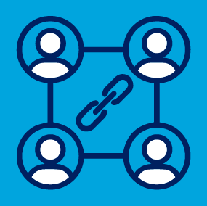
Reminder before Starting
Good Practices for the Testing Teams
Maintain communication
between teams.
Communicate with the team before you decide on something important.
Trust the HCD process.
Trust the methodology and proceed according to the original intent (even if stakeholders are hesitant).
Find solutions to small inconveniences.
Propose solutions as much as possible to avoid interrupting a test activity.

Slide 40
Activity
Simulation 1
Group Discussion
Scenario
To test a prototype aimed at collecting information on existing FP tools, you schedule an appointment with a local NGO representative to discuss the tools provided by the NGO to local health care workers. You plan to meet in the afternoon before you leave the area. The representative agreed to meet at a location where you can photograph the tools, but when you arrive, he informs you he has forgotten this detail, and the tools are not available for photographing.
How can you handle this situation?
What practice would be helpful in this case?
Maintain communication
between teams.
Find solutions to small inconveniences.
Trust the HCD process.

Slide 41
Activity
Simulation 2
Group Discussion
Scenario
While traveling in a rural area, where you are testing an FP referral booklet for women, you encounter a traditional healer. He tells you he wants to prevent his clients from going to health centers before visiting him because his work might be affected. This resistance from a local leader may create social pressure on people in the community, preventing them from using the FP referral booklet during the test.
How can you handle this situation?
What practice would be helpful in this case?
Maintain communication
between teams.
Find solutions to small inconveniences.
Trust the HCD process.

Slide 42
Activity
Simulation 3
Group Discussion
During an interview with a user to validate your prototype, you realize their answers are short and generic. The surface-level responses seem to indicate everything is good but do not provide any constructive feedback or authentic opinions.
How can you handle this situation?
What practice would be helpful in this case?
Maintain communication
between teams.
Find solutions to small inconveniences.
Trust the HCD process.

Slide 43
Afternoon Activity
Preparation
Based on what you learned this morning, you will create a prototype and test simple solutions with basic tools one can find in a typical office. The objective is not to aim for perfection but to learn by doing. Specifically, you should explore how prototyping and testing work. Tomorrow morning, you will be able to share your experience, observations, and questions. Split into three teams. Each team then chooses one of the three “How might we” questions:
Team A: How might we promote social distancing during COVID-19 in crowded places (e.g., markets, bus stops, hospitals)?
Team B: How can we ensure proper mask wearing by adults and children living in the area?
Team C: How can we promote access to reliable information about COVID-19 and minimize the spread of rumors and unreliable sources?
The following insights will inform each team’s work:
Preventive measures to stop the spread of COVID-19 (e.g., curfews, movement restrictions) are not adapted for the financial and cultural realities of life in the country, resulting in resistance to these measures.
Movement restrictions related to COVID-19 have had dramatic effects on annual crops, leading to increased food insecurity, particularly in rural areas of the country.
The lack of a centralized digital health registry has led to unreliable or delayed reporting of COVID-19-related cases and deaths throughout the country.
COVID-19 and its preventive measures have led to an increase in violence against women, particularly burglary and sexual violence during curfew hours.
Fear, misinformation, and mistrust among Europeans have led to the spread of rumors about COVID-19, resulting in resistance to testing, social distancing, and mask wearing.

Slide 44
Afternoon Activity
Instructions
Each team is invited to take a piece of paper and write down your team name and the “How might we” question you chose, as shown in the chart on the right. Together, use the questions shown to develop an idea to test.
After deciding on your idea, use simple office supplies to make a rapid prototype. Then, plan your testing round, and go test your idea today with users. Write down your observations and users’ feedback. You will present them tomorrow to the group.
Team name
How might we ….
What are the corresponding insights?
What idea would you like to test (describe or draw it)?
How will you prototype your idea?
Who will you test your idea with?
How will you test your prototype?
What do you expect to learn about your prototype? What questions will you ask?

Slide 45
END OF DAY ONE

Slide 46
Agenda for Day Two
Day TWO
1. Feedback From Rapid Testing
2. HCD Testing Tips and Tricks
3. Reviewing Prototypes and Learning by Doing
4. Next Steps
What did you learn from this experience?
How can you use these learnings in the field?
What are the roles within the research group?
What tools and documentation need to be captured?
Review the testing documents and the six prototypes.
Tailor questions to suit your community’s needs.
Activity: Role play in small groups to try out the testing documents.
What comes after testing? What is next in the process?

Slide 47
Thank you
This activity is made possible by the generous support of the American people through the U.S. Agency for International Development (USAID). The contents are the responsibility of Breakthrough ACTION and do not necessarily reflect the views of USAID or the U.S. Government.

