Slide 1
Breakthrough ACTION - Contraception Discontinuation
Human-Centered Design Capacity Strengthening Two-Day workshop for Testing Teams
Day Two
For the attention of the Core Design Team leading this activity March, 2023

Slide 2
Today’s Agenda
Day TWO
1. Feedback from Rapid Testing
2. HCD Testing Tips and Tricks
3. Reviewing Prototypes and Learning by Doing
4. Next Steps
What did you learn from this experience?
How can you use these learnings in the field?
What are the roles within the research group?
What tools and documentation need to be captured?
Review the testing documents and the six prototypes.
Tailor questions to suit your community’s needs.
Activity: Role play in small groups to try out the testing documents.
What comes after testing? What is next in the process?

Slide 3
1
Feedback from Rapid Testing

Slide 4
Activity Takeaways
Instructions
Think back on yesterday’s experience while testing.
What were some of your key learnings from this activity?
Please think about how you can incorporate these learnings into the upcoming testing round.

Slide 5
2
Reviewing Prototypes for the Upcoming Test

Slide 6
Reminder
Activity Objectives
Intent statement summary
This workshop and the testing toolkit are meant to guide SBC and FP practitioners on how to test six solutions (prototypes) to address contraception discontinuation in a local context. The prototypes were tested once in the Philippines, and they should be tested again and adapted to the needs of FP providers and women in need of contraception in a variety of countries. The next slides present the six prototypes of the core design team. Take your time to review each.
Central question
How might we understand women’s contraceptive journeys and improve HCPs’ approach to lower rates of discontinuation?
Strategic shifts
From | > | To
Assumptions of women’s reproductive journeys (e.g., transition points, circle of influence in their decision-making around contraceptive usage) | > | Becoming aware of women’s individual reproductive journeys as a whole (e.g., views, biases, barriers, and circle of influence)
Assumptions on the views and barriers of partners, family, and immediate community around contraceptive usage | > | Identifying potential barriers and areas for intervention within the family (including partner) and community
Spoon-feeding mentality, which prevents clients from thinking for themselves | > | Creating equal and sustainable partnerships with clients
Lack of knowledge around relationship dynamics and inconsistencies in client relationships | > | Identifying potential areas for improving interpersonal trust, communication, and HCP channels of support and assistance
Activity phases
Phase 1: DEFINE (2021)
Setting goals and qualitative research to understand user perspectives
Phase 2: DESIGN & TEST (2022)
Iterative prototyping and testing based on Phase One insights
Phase 3: APPLY (2023)
Implement, evaluate, and refine solutions

Slide 7
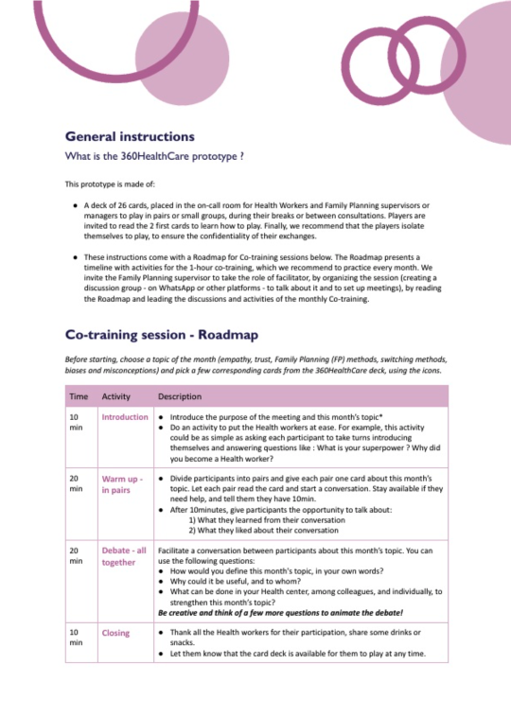
1
Collaborative FP training
A card deck and a facilitation roadmap for monthly co-training sessions about FP methods, FP switching, client empathy, trust, biases, and misconceptions. The card deck can be played during HCPs’ spare time.
Identified needs HCPs need better knowledge of available methods to prevent discontinuation (e.g., breaking misconceptions, advising on method side effects and switching). HCPs need training to address biases, including their own. HCPs need to build skills to assess side effects and encourage the right switching path for clients. HCPs need to build patient trust in their practice via confidentiality, empathy, and so on. HCP reputations in the community need to be improved by building positive client experiences. | Connected benefits Encourages virtual collaboration between HCPs Enables inter-HCP discussions to break taboos and biases Increases FP visits, method uptake, and long-term use
Users and direct beneficiaries
FP HCPs
“How might we?”
How might we re-imagine training programs for HCPs to build their confidence and FP knowledge?
Potential barriers HCPs lacking time to meet monthly or play the cards spontaneously Difficulty identifying someone to be in charge of organizing and facilitating the gathering on an ongoing basis HCPs feeling uncomfortable with the written format (e.g., literacy or comprehension) | Questions and considerations before testing Find answers: Ask HCPs when the collaborative training can best fit their busy schedules (e.g., informal opportunities beyond breaks, co-training session). What is the best timing (duration and frequency) for the co-training sessions? Are all HCPs at ease with the written format (assess literacy)? Would having the cards online be an alternate or additional option for them? Tips & tricks: Propose a (paper or online) checklist to track card use (e.g., which cards are completed, how many times cards have been played). Provide testing participants with a tool to take notes and anonymously share their insights, tips, or questions when they struggle to answer a question (guidance).
How might we ensure HCPs do not let personal biases about FP into their client relationships to ensure consistency and avoid the spread of misconceptions?
How might we inculcate a client-centric HCP mindset to support clients in normalizing the switching of methods and building a customized FP journey with them?
How might we strengthen the exchange of knowledge and capabilities between HCPs to support peer learning and create a community practice?

Slide 8
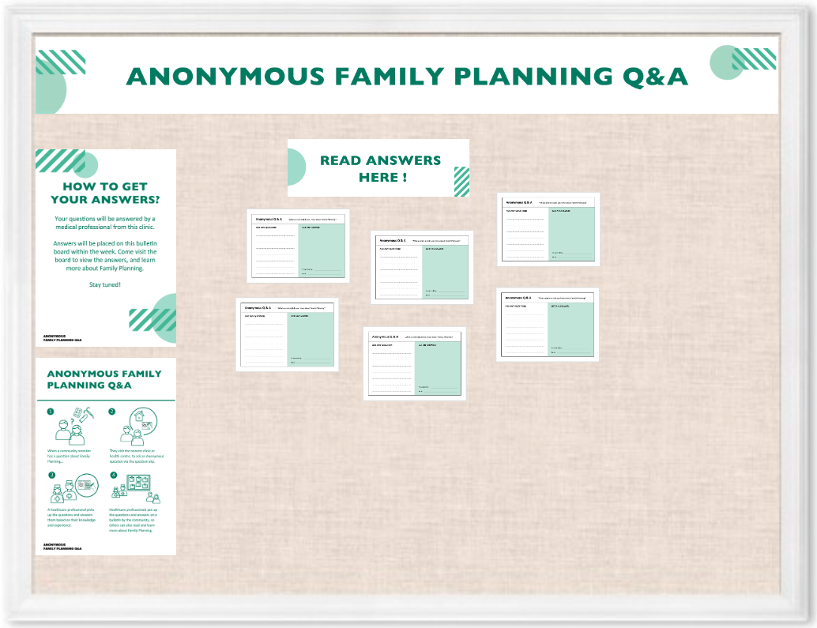
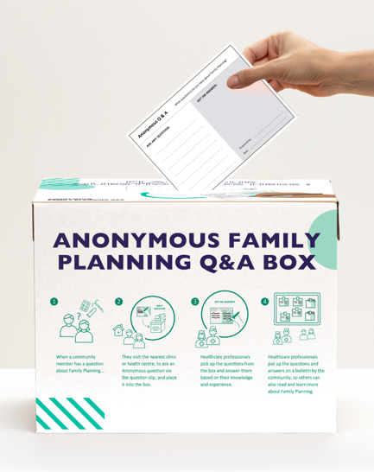
2
Anonymous Q&A box and board
A physical bulletin board filled with HCPs’ answers to clients’ FP questions, which they submit to an anonymous “Q&A box” near the board. This system creates a safe space for clients to ask about sensitive information without feeling shame.
Identified needs Clients need a way to get credible and accurate information about contraception and other FP matters. Clients need a way to ask sensitive or intimate questions while maintaining their privacy and protecting their identity. Clients need a more informal way to learn more about FP and contraception. HCPs need a way to share their knowledge outside of the consultation context, where clients may feel embarrassed or judged. | Connected benefits Encourages sharing about personal issues surrounding contraception Provides professional advice and support Promotes sharing of experiences Fights stigma surrounding FP issues
Users
Discontinuers
Current users
Direct beneficiaries
Discontinuers
Current users
FP HCPs
“How might we?”
Potential barriers HCP may not have knowledge of FP topics. Only women who already go to the health care center will benefit. Answers are not immediate. | Questions and considerations before testing Find answers: Where is the safest place for the Q&A box (e.g., inside or outside the healthcare center) to protect users’ anonymity? Would a digital version of this prototype work in your context? When will the HCP gather and answer the submitted questions? Would a readily available FAQ sheet or Q&A cards be useful for HCPs to use to save time? Can additional Q&A boxes be placed in high-traffic areas in the community? Where would these areas be? Where can HCPs go for answers to questions they may not be familiar with? Tips & tricks: For less literate members of the community, gather questions and answers for verbal sharing.
How might we encourage openness when sharing about contraception use as a sensitive and personal topic?
How might we prevent incorrect beliefs and miscommunication about FP from spreading within the community?
How might we help clients troubleshoot challenges or obstacles on their FP journey to support them in continuing or switching methods?
How might we build peer support networks if and when current and past users encounter FP challenges or obstacles?

Slide 9
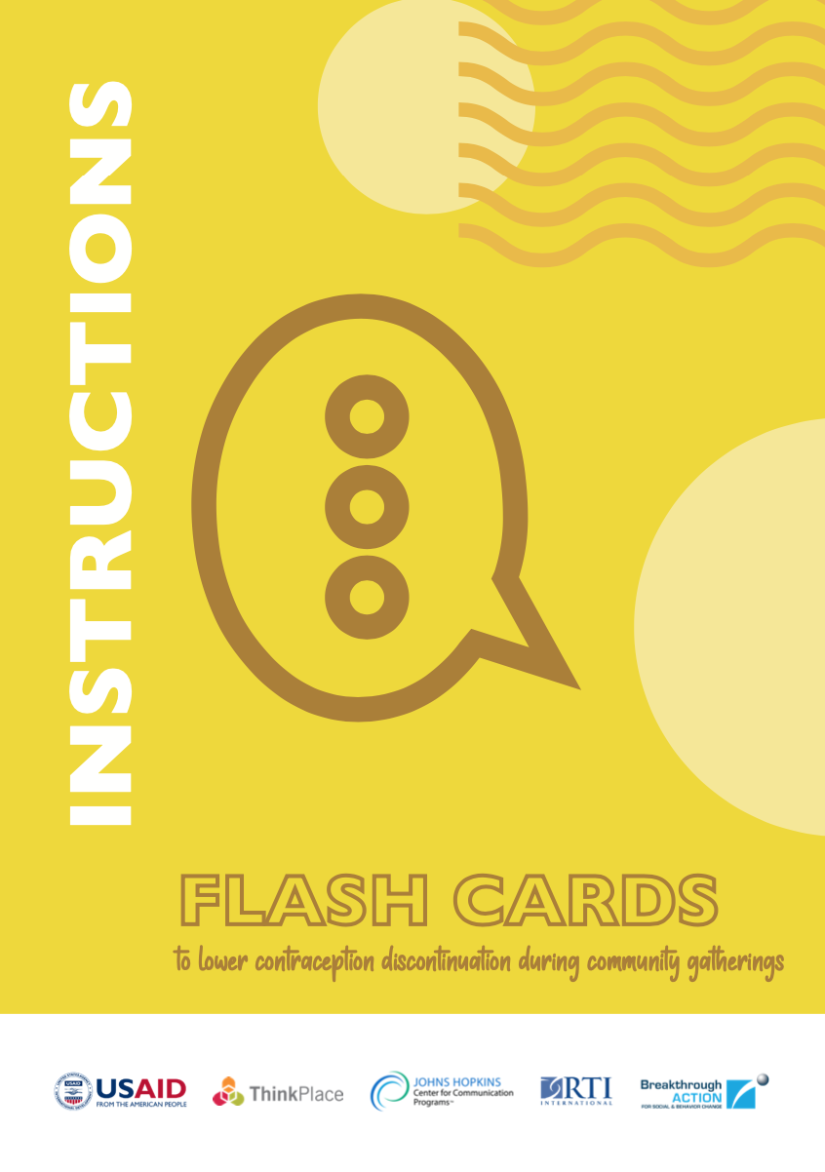
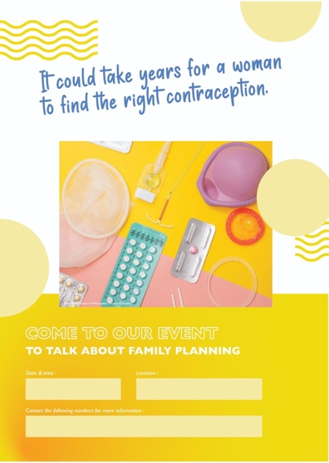
3
Discontinuation community awareness tools
This prototype includes three posters displayed in community spaces, pharmacies, and health facilities to answer questions on side effects and promote community discussions led by local community leaders and HCPs. It also includes a set of flashcards to be used by community leaders and HCPs to facilitate group discussions and address biases.
Identified needs With support from trusted influencers, diffuse accurate FP information to peers, family members, and past clients to counter biases and hearsay. Reach out to all women outside of the HCP's network. Raise awareness and break stigmas on the community level. Have a trusted person (e.g., community leader) support FP information and its diffusion. Share familiar scenarios and experiences to encourage women to reach out to their HCP. | Connected benefits The playful and celebratory aspect of the debate fits usual ways of community outreach and breaks the sensitive aspect of FP topics. Teenagers, young women, and influencers (e.g., husbands, other family members) can attend.
Users
FP HCPs
Community leaders
Current users
Direct beneficiaries
Discontinuers
Women out of HCP network
Husbands & influencers
“How might we?”
Potential barriers Community influencers need to support diffusion of information to gain users’ trust. Some gaps in information about FP switching and side effects may persist. | Questions and considerations before testing Find answers: Will HCPs and community leaders continue to hold these debates? Could this gathering be integrated into existing meetings, and if yes, how? Tips and tricks: In the guidelines, recommend choosing the right person to facilitate the event (e.g., private midwives). Test what works best with targeted cohorts and keep them entertained and engaged so that they attend meetings regularly. Determine if community leaders want to be associated with this event and with FP in general. Determine if the event is suited to everyone and if all cohorts can easily gather and actively participate.
How might we encourage openness when sharing about contraception use as a sensitive and personal topic?
How might engage existing community groups in conversation about FP and its benefits?
How might we improve HCP outreach methods to increase relevance with clients across different age cohorts?
How might we get key influencers (e.g., husbands, family members, peers) more involved in supporting clients' FP journeys?

Slide 10
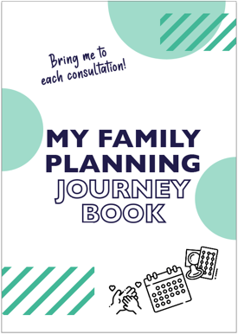
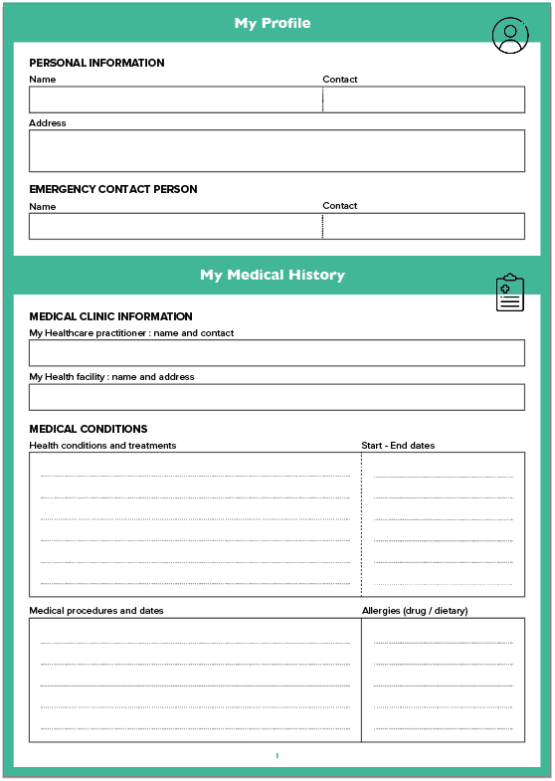
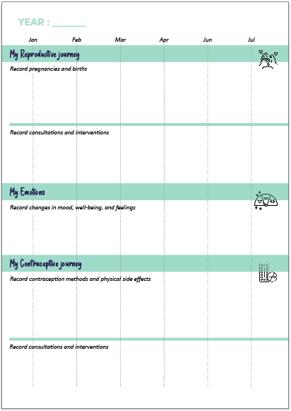
4
“My Family Planning Journey Book”
This booklet is a visual tool for women to track their FP experience. HCPs then use it during consultations to share notes and follow-up instructions. HCPs and pharmacists who distribute the booklet should help clients fill in their medical and reproductive history and prompt them to track their own FP use and experiences (e.g., side effects, emotions).
Identified needs HCPs need a reliable way to understand clients’ medical history quickly and holistically so that they can provide better follow-up recommendations. Clients need to track their side effects, well-being, and the efficiency of various FP methods. Women need a way to understand their experience along their reproductive journey. HCPs and their clients need to form relationships so that HCPs can effectively monitor and advise clients. | Connected benefits Encourages women to track and share personal experiences, good and bad, with their HCP Provides an opportunity to build trust in the HCP and create user loyalty for a qualitative follow-up Enables both HCPs and clients to learn about FP based on client's experience Supports HCPs in tailoring feedback and advice to clients
Users
FP HCPs
Discontinuers
Current users
Women out of HCP network
Potential barriers User literacy and comprehension of the tool Sharing personal data | Questions and considerations before testing Find answers: Do women experiencing side effects usually reach out to the HCP for advice? How does the booklet impact clients’ experience and HCP interaction frequency? How and how often do women use this tool at home and during consultations? Do women feel comfortable filling in the information (i.e., are there literacy issues)? Would an electronic version of the booklet be a good alternative (consider accessibility to network and phone credit for updates)? Do HCPs have records and do they usually take notes in these records? How do HCPs take notes during the consultation and for how long? Can they use notes at the same time as using the booklet? Where and when should this tool be introduced to clients?
Direct beneficiaries
Discontinuers
Current users
Women out of HCP network
“How might we?”
How might we enable HCPs to better track a client's FP journey?
How might we help women troubleshoot challenges or obstacles along the FP journey and support them in continuing or switching methods?

Slide 11
5
“#Let’sTalkContraception” stickers
This sticker set is designed to trigger FP conversations on Viber, WhatsApp, Messenger, or other social media platforms. The stickers depict an iconic character and encourage users to talk about contraception and side effects and to visit an HCP. HCPs send the sticker sets to clients, who then share them within their social circles, reaching women outside of the HCP’s reach.
Identified needs Women need a way to talk with one another or their HCPs about FP, FP methods, switching methods, their FP journeys, and their experiences to build informal social support and networking. Health centers and HCPs need to work with clients' strong reliance on informal peer communities. | Connected benefits Creates social support, especially useful to women beyond the reach of the HCP Enables community member to share and talk about contraception experiences more freely
Users
FP HCPs
Discontinuers
Current users
Women out of HCP network
Direct beneficiaries
Potential barriers Digital platform requirements and limitations Moderation of online platforms (who is in charge?) Linking clients to correct information and support Avoiding negative information spreading and monitoring hashtags and links | Questions and considerations before testing Find answers: Do digital platforms work? Where do online users gather in your community? Can users identify the side effects as shown on the visuals? Do these prompts help users to speak organically about their personal experiences with one another? What is the best online platform in your country for trusted information? How are the stickers introduced? How do they get used and promoted? Tips and tricks: Identify how, when, and with whom the stickers are most used. Include avenues where users can find credible information. Encourage users to find reliable platforms to exchange information.
Discontinuers
Current users
Women out of HCP network
“How might we?”
How might we reduce clients' fears and anxiety around starting their FP journey?
How might we improve HCP outreach methods to increase relevance with users across different age cohorts?
How might we provide continuity in the HCP-client relationship beyond formal consultations at the health center?
How might we encourage openness when sharing about contraception use as a sensitive and personal topic?

Slide 12
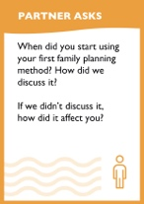
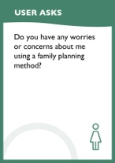
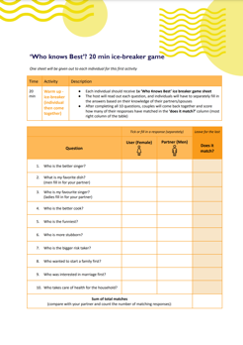
6
Couples’ FP event
At this fun event, couples can engage in candid conversations about FP and contraception and learn about the benefits, struggles, and potential side effects. The prototype includes a facilitation guide, activity flash cards, and a certificate.
Identified needs Diffuse FP information to peers, family members, and past clients that challenges biases and hearsay and is supported by trusted influencers. Reduce the barriers to help couples talk about contraception with less apprehension. Get partners more involved in supporting women's journeys, encouraging women to continue using a method. Create an informed dialogue between men and women to reduce misconceptions. | Connected benefits Encourage candid conversations about FP and contraception within the family unit. Learn about the benefits, struggles, and potential side effects a woman may experience to help partners understand what to expect.
Users
FP HCPs
Community leaders
Discontinuers
Current users
Women out of HCP network
Husbands or partners
Potential barriers Lack of time and availability among HCPs Lack of availability and potential conflicting beliefs among community leaders | Questions and considerations before testing Find answers: Does this prototype increase FP knowledge among couples in your community? What other FP events could you leverage to promote this event? Will HCPs have sufficient time to run these programs? What is the best schedule, duration, and setting for these programs? What is the best format (e.g., picnic)? Who would be in charge of organizing and facilitating the gathering so that it is sustainable? Does this prototype reduce the barrier between couples so that they can freely discuss the topic? Do couples respond well to the questions? Are they able to create conversation with one another?
Direct beneficiaries
Discontinuers
Current users
Women out of HCP network
Husbands or partners
“How might we?”
How might we encourage openness in relationships in discussing a sensitive topic like contraception use?
How might we get key influencers (e.g,. husbands, family, peers) more involved in a woman’s FP journey to ultimately support her?

Slide 13
3
Completing the Testing Documents

Slide 14
Reminder
Activity Steps
From start to implementation
Use the capacity strengthening slide deck to train the testing teams
We are here
4
Compose your core design team
1
Test all prototypes with designated cohorts and hold daily debriefs between each testing team
5
Use the templates to develop the testing guide, agenda, questionnaires, and notetaking formats for testing
2
Harvest all testing data and use provided tools for analysis and adaptation (workshop and prototypes)
6
Recruit consultants, if needed, to ensure the right testing team size
3
Test the adapted prototypes again or implement a selection of prototypes in your context
7

Slide 15
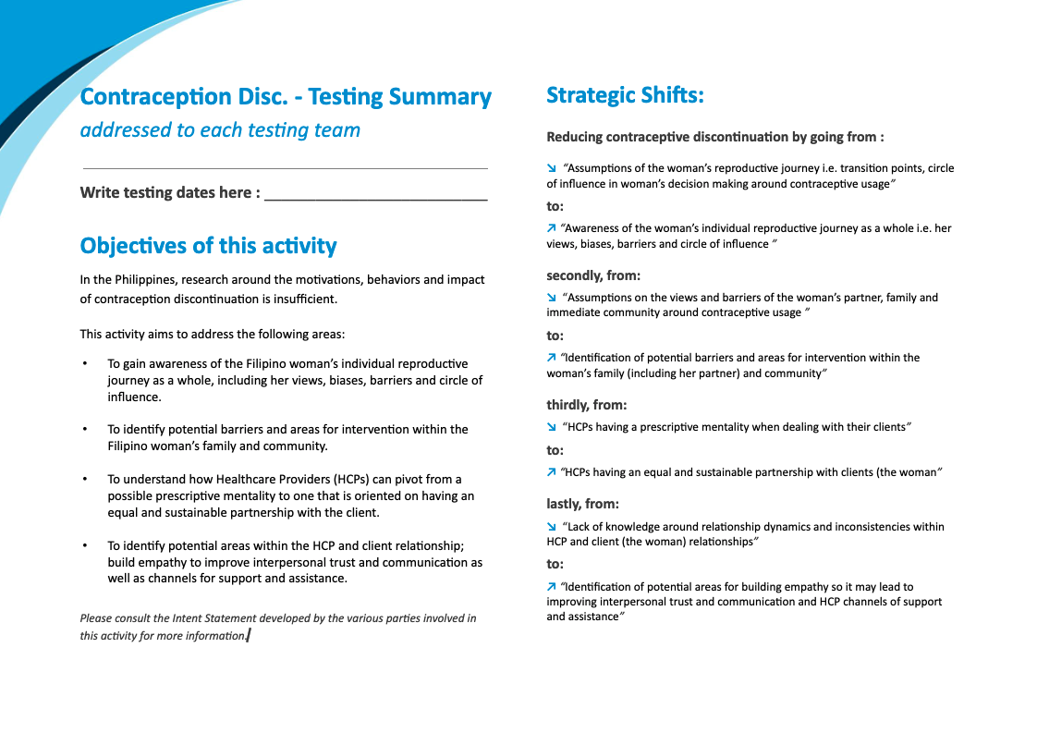
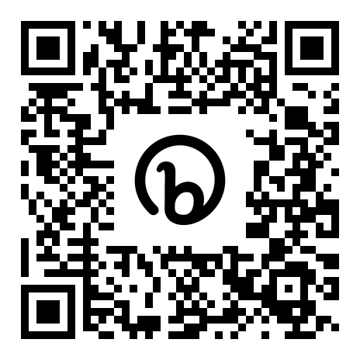
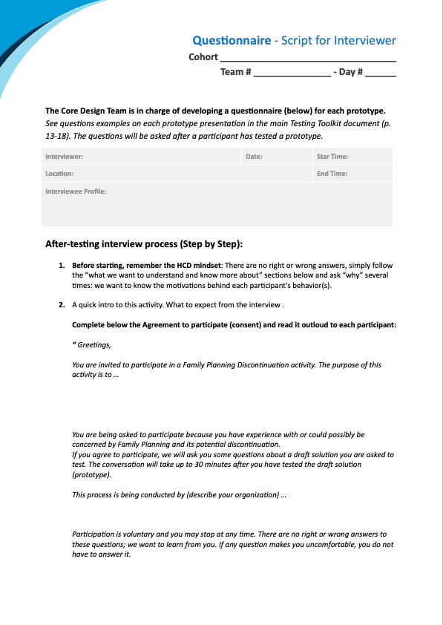
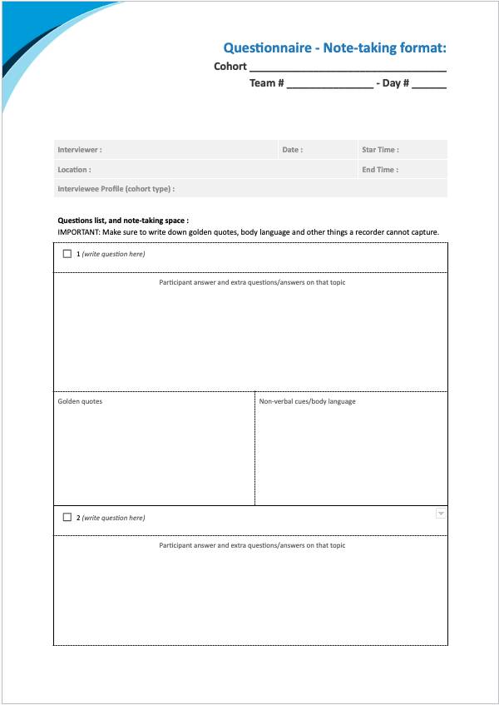
Resources
Supportive Testing Tools for Each Team
The testing guide. This document summarizes important information and advice to guide teams before and during the test round. It must be adapted by each team before testing.
Documentation for the six prototypes. The six folders contain the files for each prototype, ready to be printed for each testing team.
Questionnaires and notetaking templates. These two documents provide a structure and tips for the interviewer and notetaker of each testing team. The questions must be written by the team before testing.
All of these documents can be found via this QR code and have been printed for this workshop.

Slide 16
Questionnaires and Note-Taking Templates
Team Adaptation of the Document
Together, get acquainted with both the questionnaire and notetaking templates. Then, develop questions for each of the six prototypes to be tested, with guidance from the questionnaire and the “Questions and considerations before testing” section on each prototype description slide. Important: Unlike standard interviews, in which you may ask a series of pre-planned questions often answered by “yes” or “no,” human-centered design requires qualitative interviewing: open-ended questions giving the interviewee freedom to explore topics and perspectives important to them. This process takes time. Do not rush through it. All teams must ask the same questions for each prototype.

Slide 17
LUNCH BREAK

Slide 18
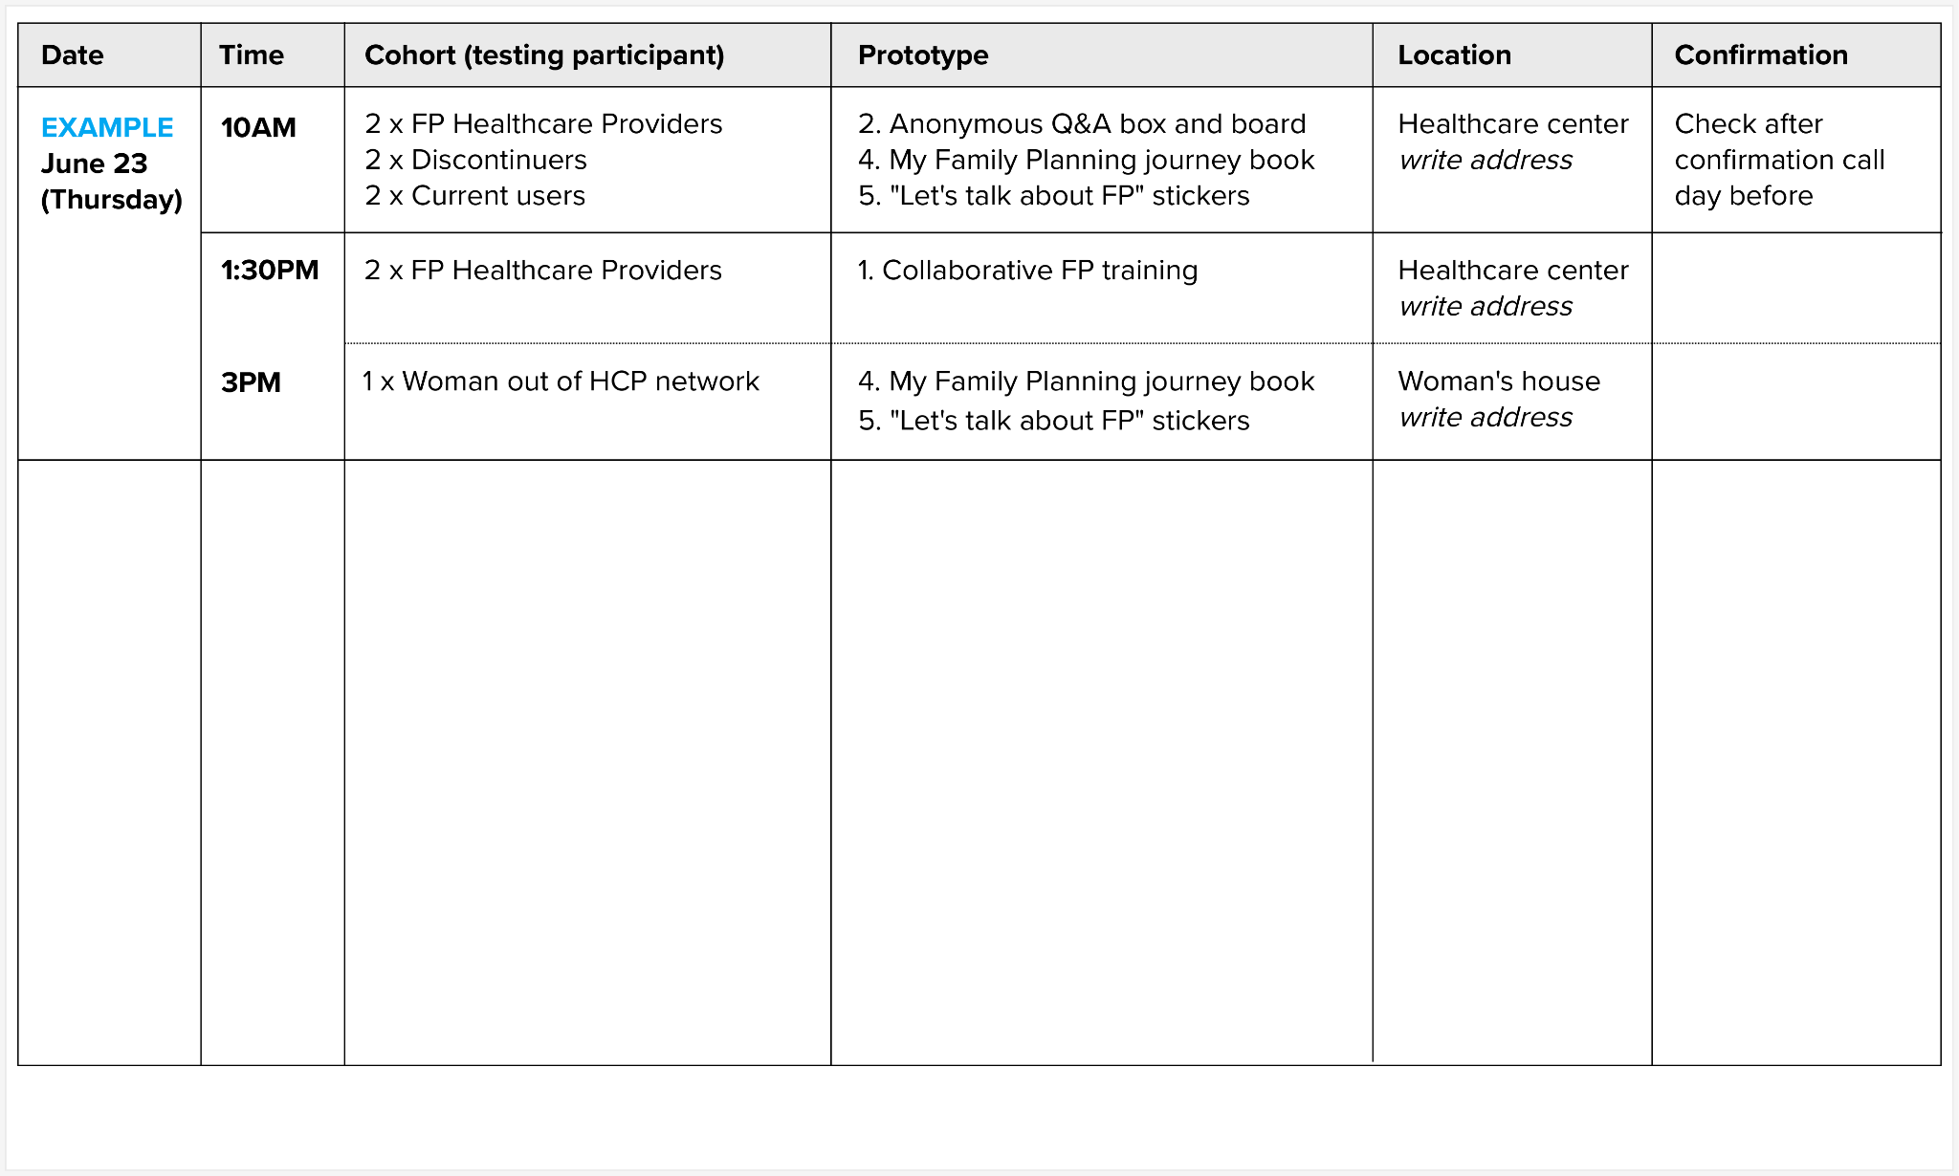
Testing Guide
Team Adaptation of the Document
Each testing team is invited to open their testing guide, read it together, and adapt the following elements:
Assign roles (listed in the guide) to each team member.
Develop team testing dashboard (see example at right and in the guide).
Get acquainted with best practices listed in the guide.

Slide 19
4
Final Recommendations and Role Play

Slide 20
Recommendations for Testing
Adopt the HCD Mindset
Practice Empathic Listening
Navigate uncertainty and embrace ambiguity.
Observe with a beginner's mind and curiosity.
Keep an open mind and stay creative.
Iterate and learn from failure.
Remember: Collaboration is everything.
Follow people's stories rather than trying to elicit the answers we want from them.
Talk less and listen more to what the participant is telling you.
Listen to understand. Do not judge the information being shared with you.
Be curious and deepen the information obtained with new questions.
Ask "Why?" when participants answer with "yes," "no," or short or generic answers.
This human-centered project aims to improve understanding of all the complexities of participants’ behavior. Avoid sharing your opinions with participants, which may prevent them from sharing theirs.
Encourage feedback by using statements such as "Tell me more about this … " Humans like to feel heard, so take the opportunity to ask for all the details.

Slide 21
Recommendations for Testing
End HCD Testing with Qualitative Interviews
During qualitative interviews,
Seek consent of the interviewee and ensure a safe, calm interview environment;
Ensure the interviewee actively participates;
Invite the interviewee to explore and reflect on their contraceptive discontinuation story (related to usage, influencers, and channels of information) without assuming where it begins and ends;
Give the interviewee space to share things that are most important to them; and
Encourage storytelling about the interviewee’s experience in its full richness and complexity.
“WHY?” “WHAT COULD BE BETTER?” “SHOW ME.”

Slide 22
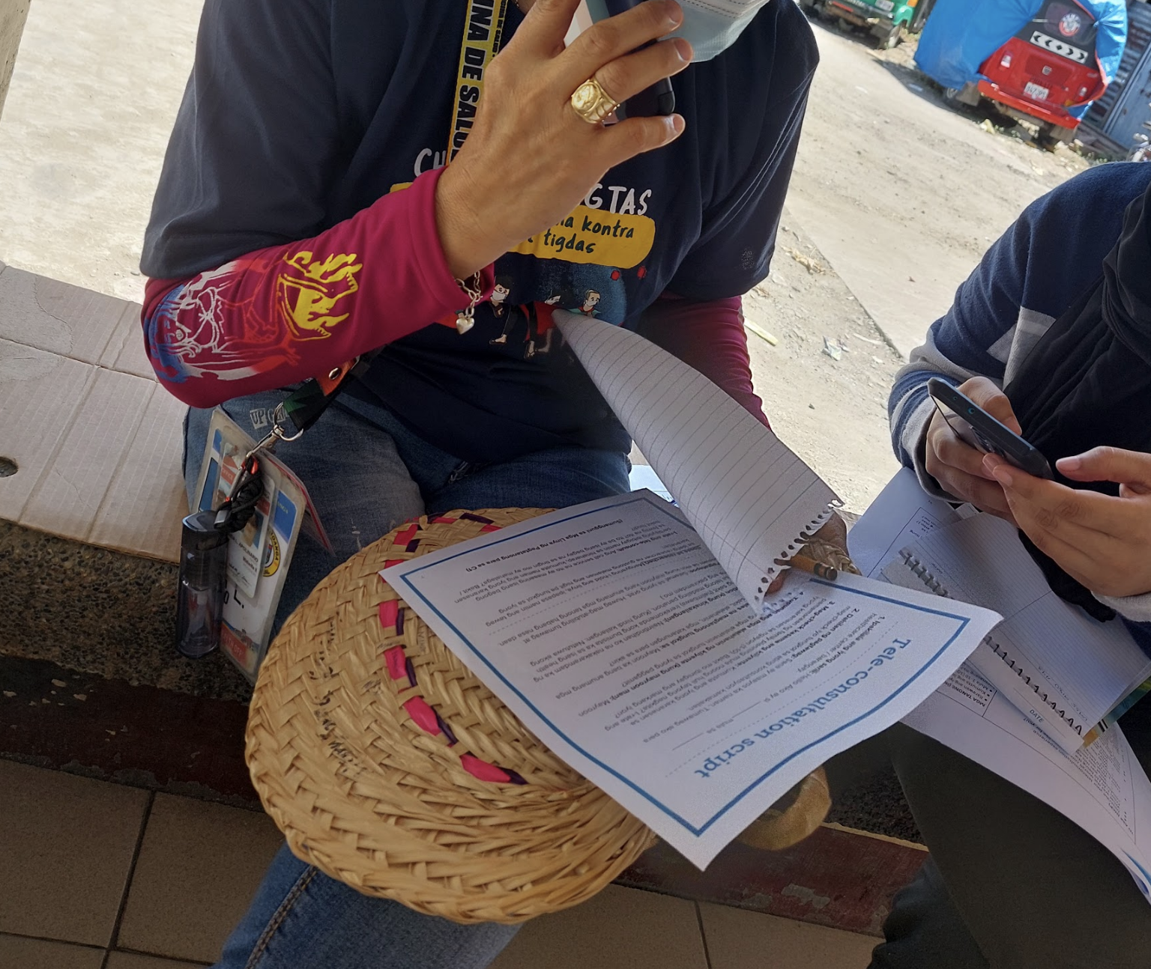
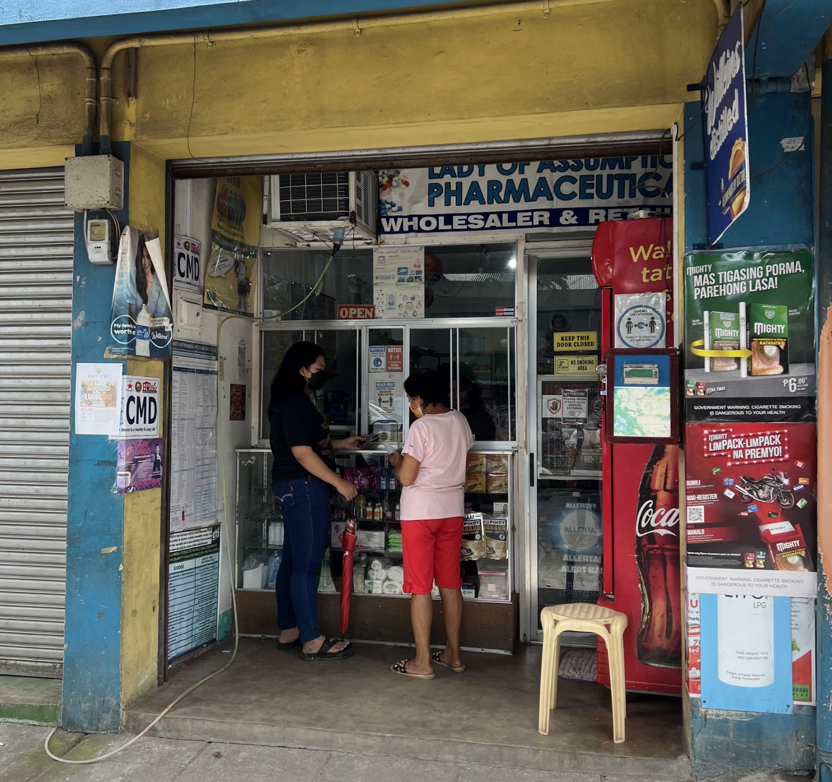
Recommendations for Testing
Record Observations During Qualitative Interviews
To understand complex human behavior, each testing team should observe interviewees in their regular settings before, during, and after interviews. Teams also should observe groups outside of the interview setting. People’s actions sometimes contradict what they say. Observation thus helps the research team understand key interaction points within a particular product or communication format, such as pain points or frustrations, and thus identify opportunities for solutions. This research technique can generate a more objective understanding of what drives human behaviors and social norms. Observations made during the interviews help the research team understand key elements of the research (e.g., how users feel about contraceptive methods and usage, their relationships with HCPs, key decision points along their journeys, how they interact with their circle of influence, and what types of information channels they visit and use).

Slide 23
Activity
Role Play
What to think about during the role play:
Group: Is this question tailored to the people in your community? What would you paraphrase?
Interviewee: Did you feel comfortable with this question?
Interviewer: How would you adapt or improve this testing document?
One person plays the interviewer. One person plays the interviewee. Try out the testing documents as you go through the questions.
Switch roles after 10 minutes.
The rest of the group observes and provide feedback at the end.

Slide 24
END OF TRAINING

Slide 25
Thank you
This activity is made possible by the generous support of the American people through the U.S. Agency for International Development (USAID). The contents are the responsibility of Breakthrough ACTION and do not necessarily reflect the views of USAID or the U.S. Government.

