Slide 1
Family Activity
C H A L L E N G E C A R D S

Slide 2
Family Activity
C H A L L E N G E C A R D S
Instructions:
Pick at least one activity to do together during the week between Family Space sessions. It can be from the cards, or something else you agree upon.
Document that you have completed the activity - take a picture, write down what you talked about, bring a ticket stub, etc.
At the beginning of the following class, share the “proof” of which activity you completed.
Families that complete the challenges they promised to complete will have the opportunity to be awarded the "Best of the Best Family."
In the final session, you will have the option to share stories about the activities you completed (i.e., what you learned, what changes you experienced, if any, etc.)

Slide 3
A C T I V I T Y C A R D
ACTIVITY
Parents help children with their homework
MOMENT OF THE DAY
After dinner
DURATION
30 minutes

Slide 4
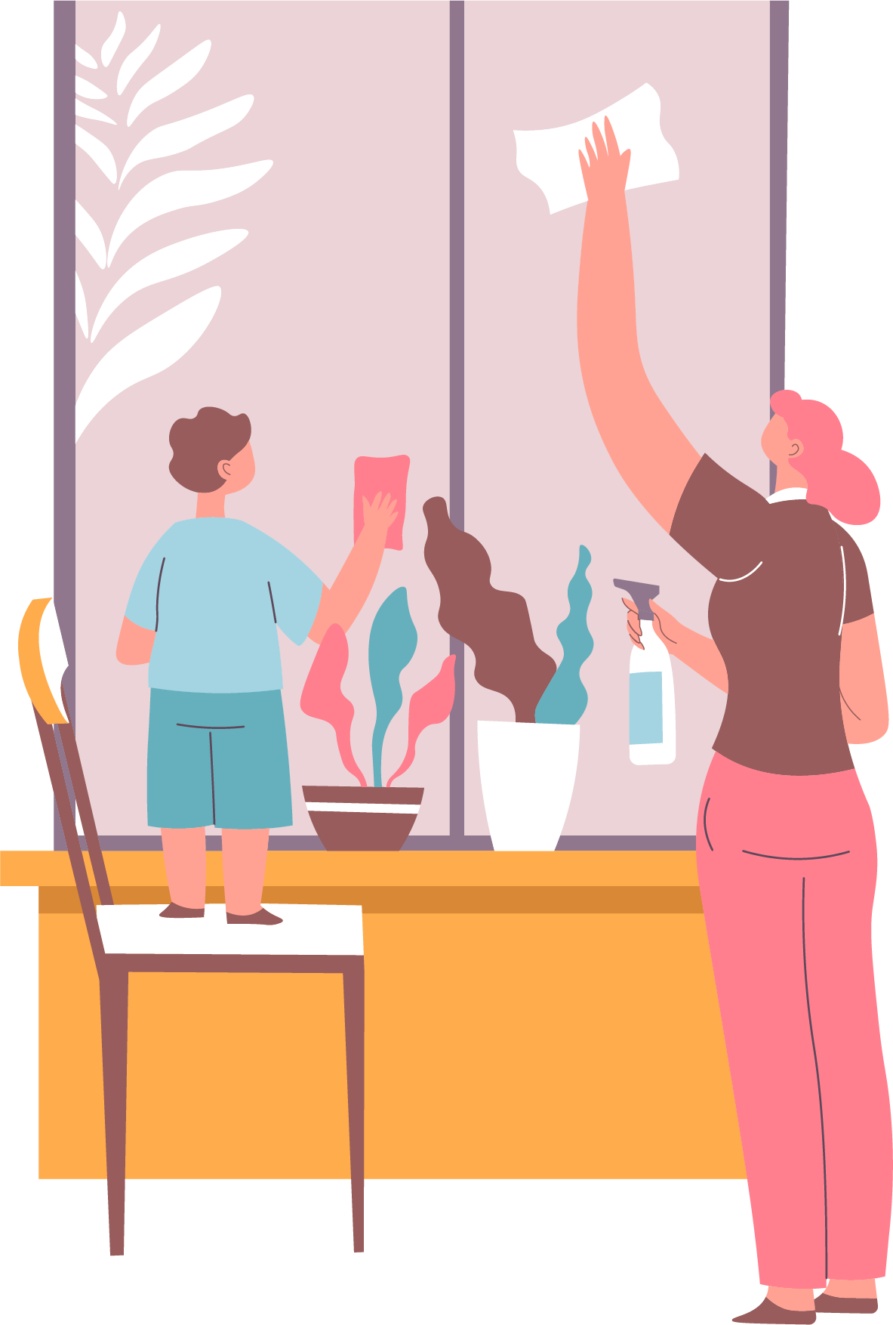
A C T I V I T Y C A R D
ACTIVITY
Clean up as a family
MOMENT OF THE DAY
Weekend
DURATION
In the morning

Slide 5
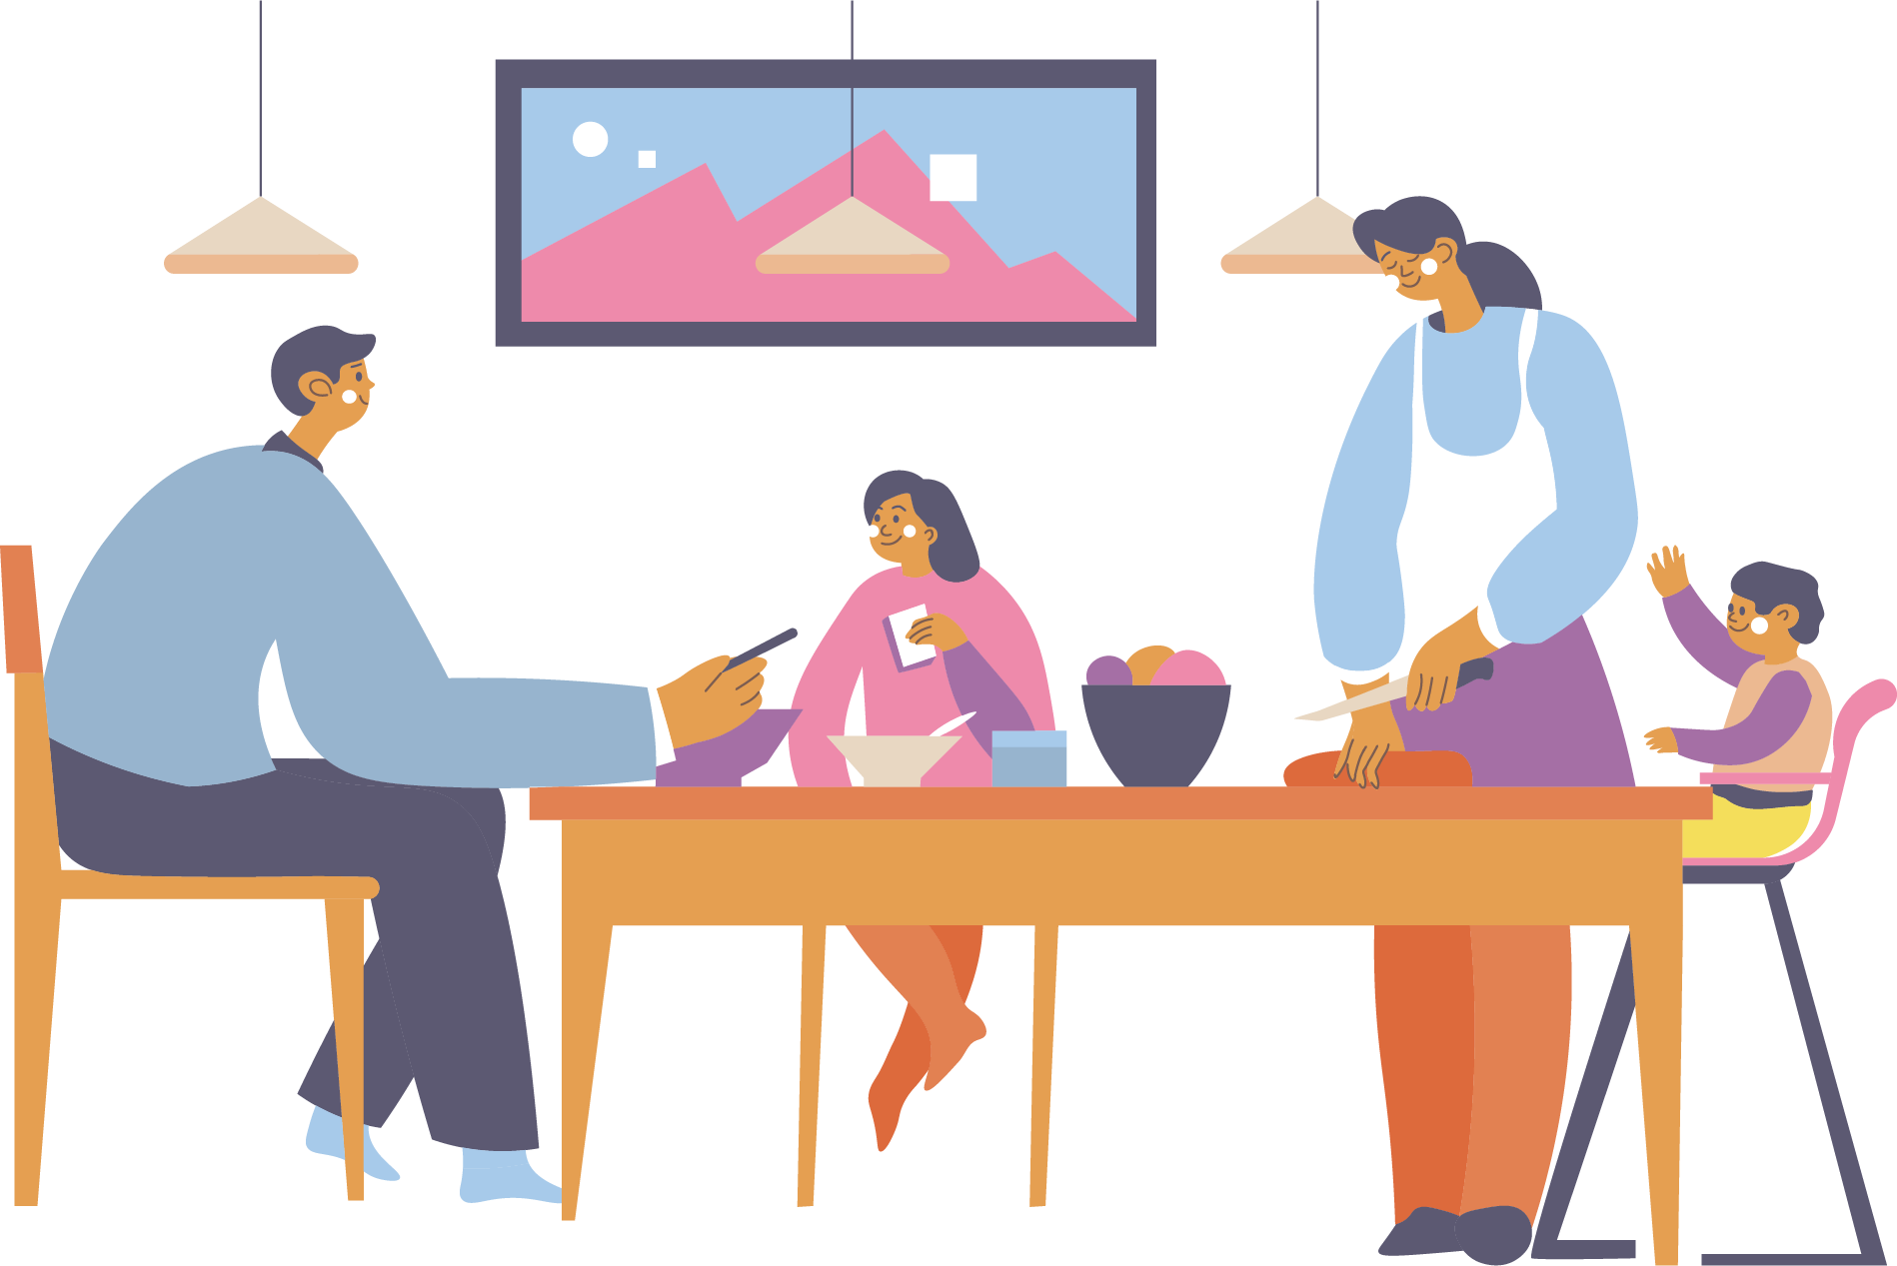
A C T I V I T Y C A R D
ACTIVITY
Parents share stories about their childhood
MOMENT OF THE DAY
During dinner
DURATION
15 minutes

Slide 6
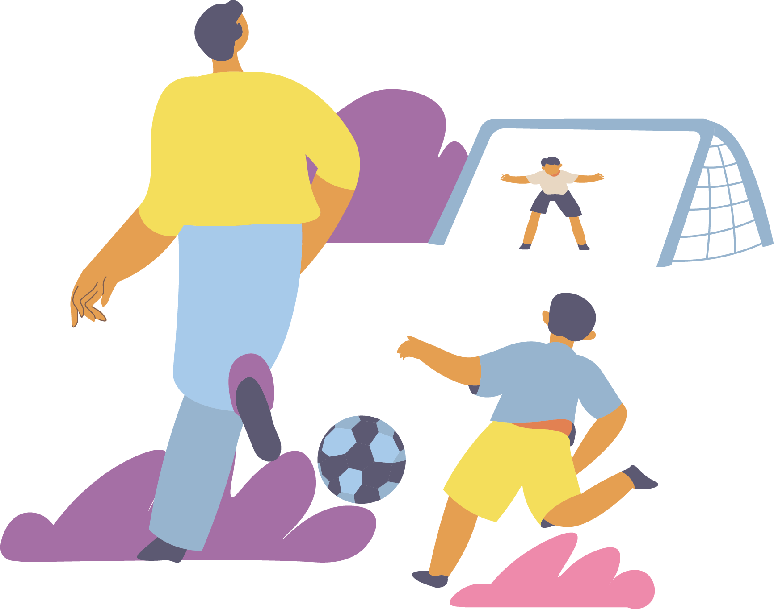
A C T I V I T Y C A R D
ACTIVITY
Play sports or exercise together
MOMENT OF THE DAY
Weekends
DURATION
30-60 minutes

Slide 7
A C T I V I T Y C A R D
ACTIVITY
Do a favorite activity or hobby together
(e.g., hiking, cooking, going to a festival, etc.)
MOMENT OF THE DAY
Weekend
DURATION
1 hour

Slide 8
A C T I V I T Y C A R D
ACTIVITY
Have a family karaoke session
MOMENT OF THE DAY
Weekends
DURATION
Customizable

Slide 9
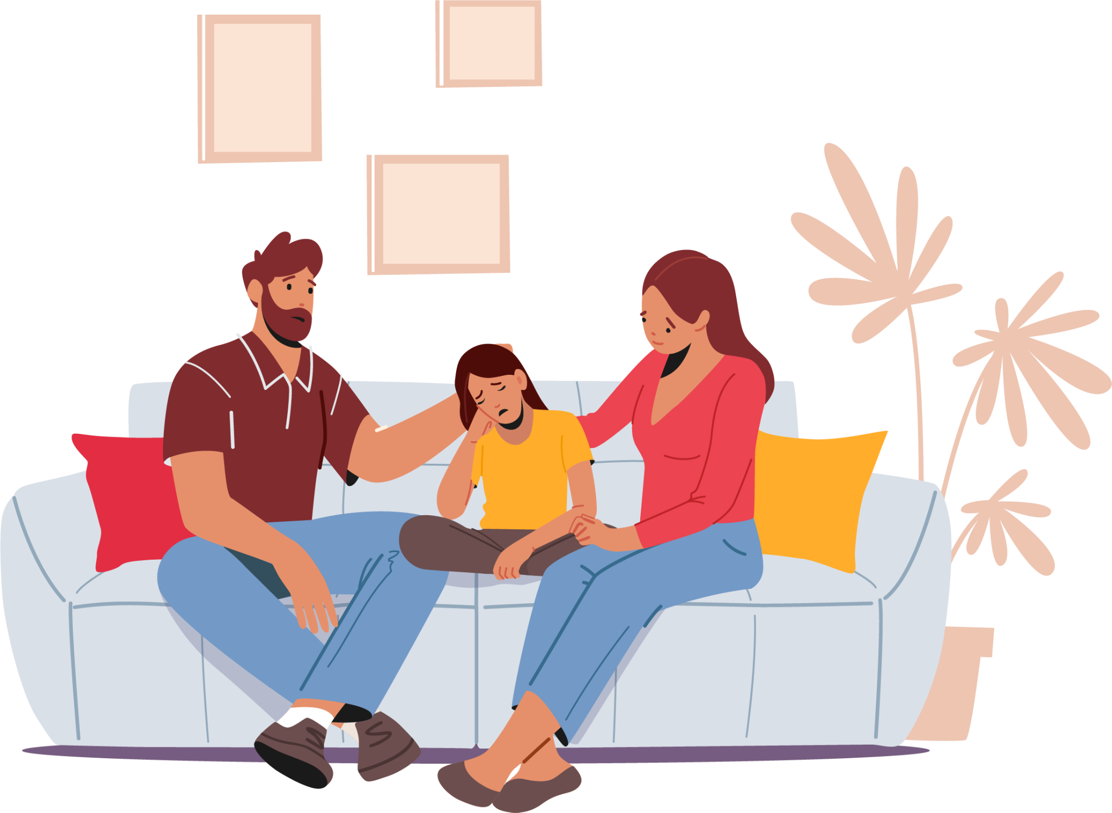
A C T I V I T Y C A R D
ACTIVITY
Share the best and worst parts about their days
MOMENT OF THE DAY
Dinner time or
before bed
DURATION
15 minutes

Slide 10
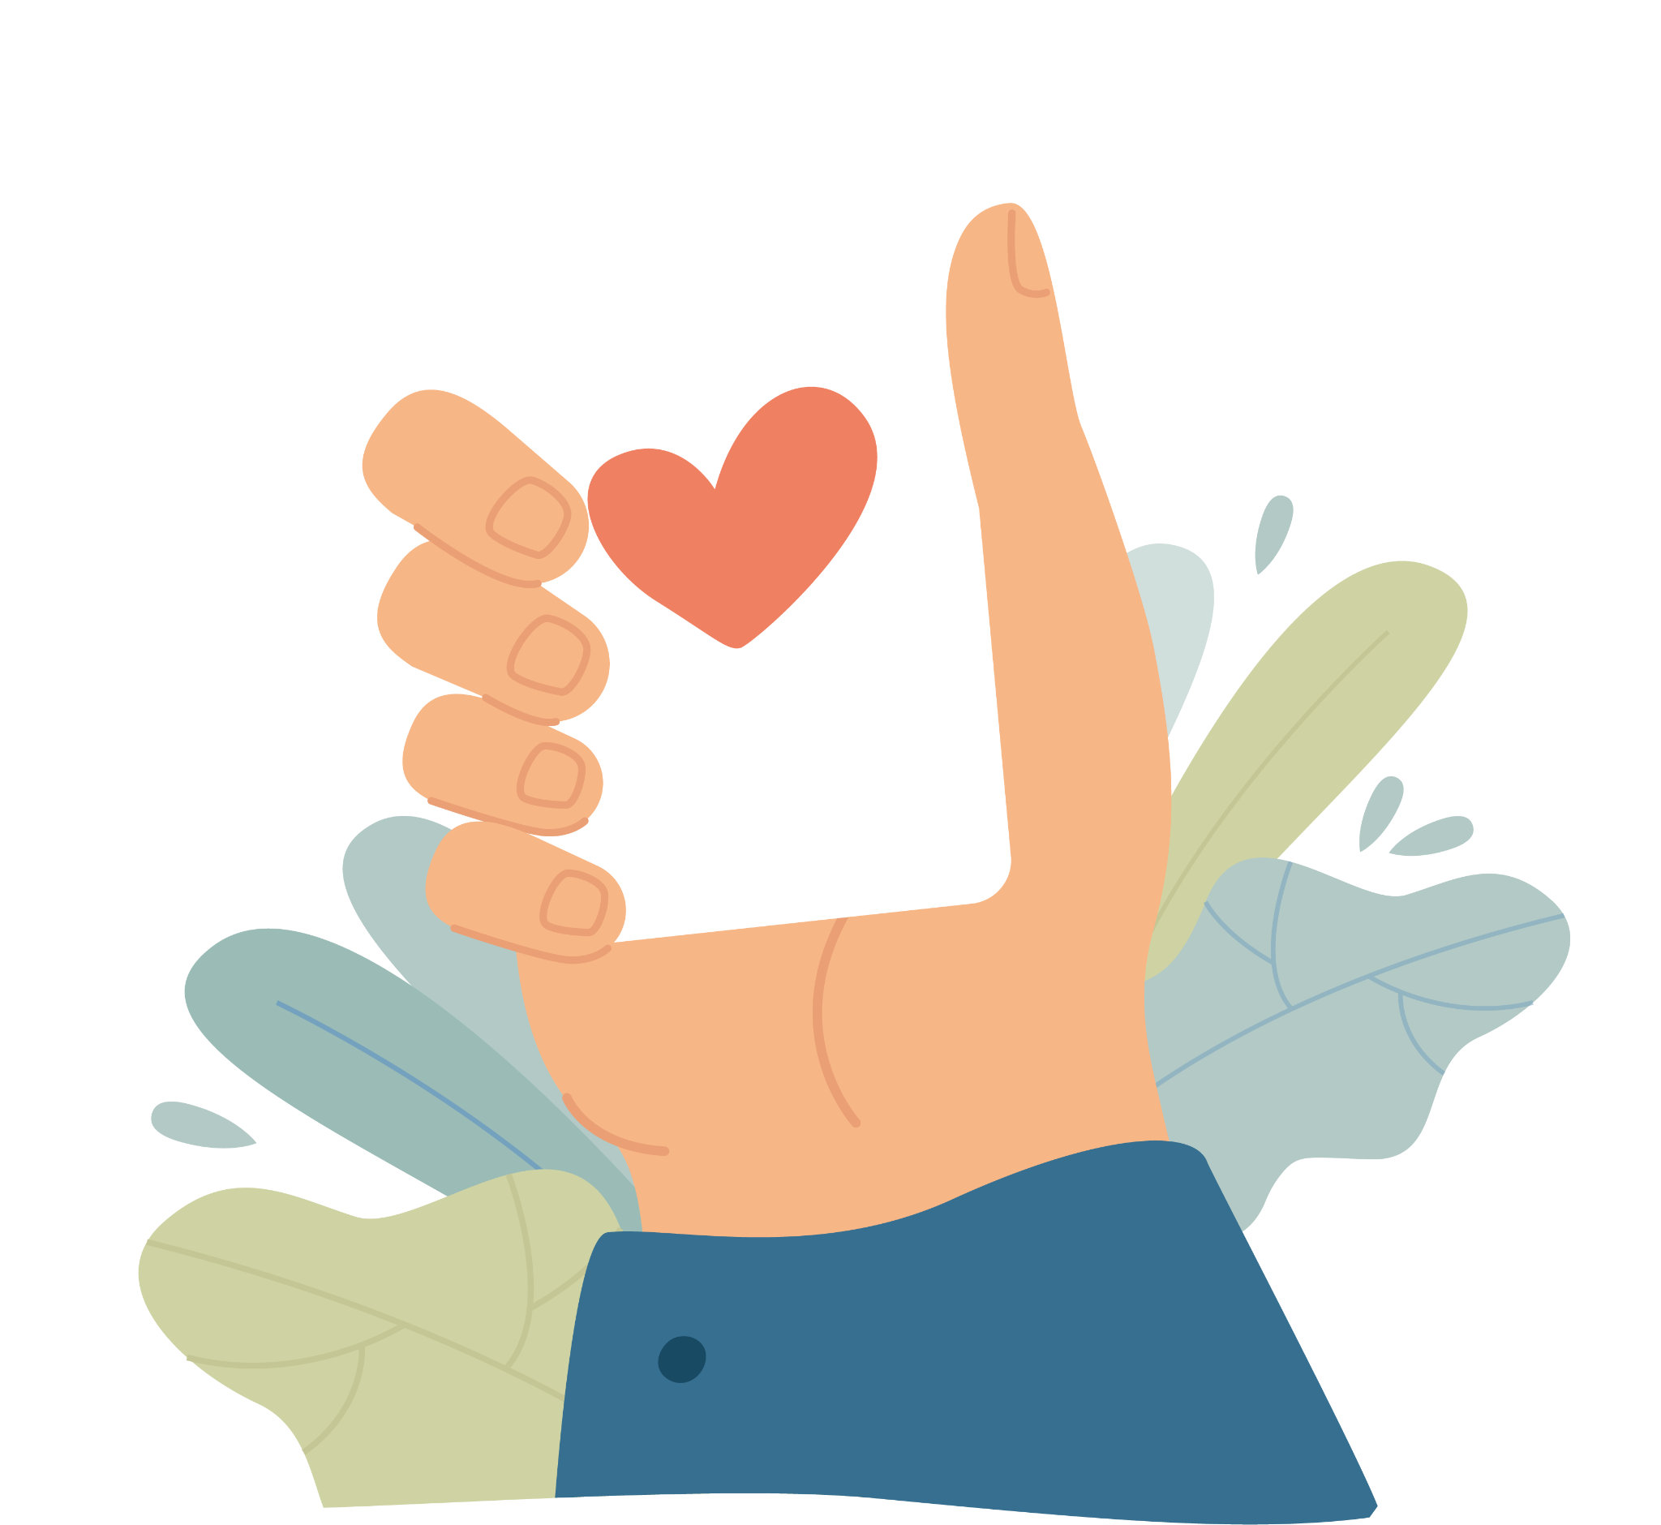
A C T I V I T Y C A R D
ACTIVITY
Play the Empathways Card activity
MOMENT OF THE DAY
Customizable
DURATION
15-30 minutes

