Slide 1
Introduction

Slide 2

Hello everyone, welcome to the Interactive Video screening

Slide 3

Thank you for taking the time to participate in the viewing of this video.

Slide 4

There are a few things you need to be aware of during this screening.

Slide 5

First, the video is interactive, meaning you
(the audience) influence the outcome of the story.

Slide 6


Second, the video will pause and show two options to choose from: A and B.

Slide 7



Third, this interactive video will be played in 3 parts. You can choose each decision point. There will be a discussion afterwards.

Slide 8

Choose the option that you think reflects what actually happens in your environment (not what you think should happen).
Remember, this video does not aim to test if you would pick the ideal scenario, but to choose according to what you think most likely happens most in your context.

Slide 9

Each viewer is free to make their own choices.
We kindly ask you to respect the choices of other viewers.

Slide 10
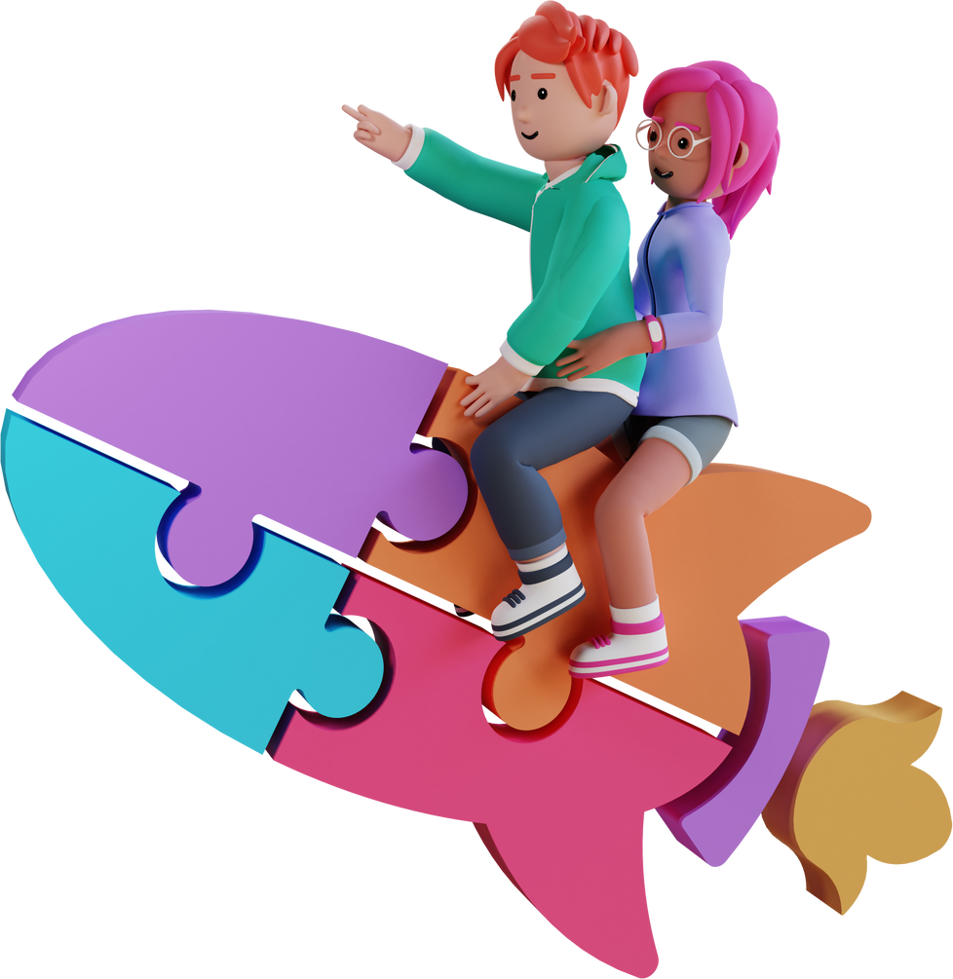
Finally, please enjoy this interactive video and embark on a journey to predict the future from the choices you make!

Slide 11

You are the decider of this storyline.
Happy watching!

