Slide 1
Creating a gender-equitable environment for very young adolescents
What is a gender-equitable environment?
Why should we create one?
How will we do it?
Presented by: [ORGANIZATION NAME]| DATE
Notes:
Adaptation notes:
Customize the date, location, etc. to your setting.
Presenter notes:
Welcome participants and thank them for their time
Explain that you will be sharing about a new pilot program that you would their involvement in

Slide 2
ICEBREAKER!
Notes:
Adaptation notes:
Choose an icebreaker to open up your presentation. It should be something fun and energizing that helps participants get in the right mindset. Consult the Activity Bank for ideas.
Customize this slide to share any high-level instructions that participants may need to know.

Slide 3
Let’s get on the same page…
Notes:
Presenter notes:
Use this as a transition slide to explain that first you will review some key terms you will use during this presentation. Level-setting around these terms and explaining them in easy terms is very important, as when many people here the word “gender” they may automatically think of transgender or even just think about something as simple as different restrooms for boys and girls. While those are related terms and topics, they are not the core of this discussion or intervention package.

Slide 4
What are gender norms?
Notes:
Presenter notes:
Ask the audience: What are gender norms? How would they define gender norms?
Get a few people to respond before moving on to the next slide where gender norms are defined.

Slide 5
Informal rules or expectations for how boys and girls, and men and women should look, act and think.
Gender norms =
Notes:
Presenter notes:
Read the definition on the slide.
Clarify that gender norms impact people of all ages
Optional: elaborate on this definition by using the definition provided on page 6 of the Breakthrough ACTION Messaging Framework for Creating a Gender-Equitable Environment for Very Young Adolescents: https://breakthroughactionandresearch.org/wp-content/uploads/2023/05/Creating-a-Gender-Equitable-Environment-for-VYAs-Messages-and-Evidence.pdf
Gender norms are “the informal rules and shared social expectations that distinguish expected behavior on the basis of gender. Norms are learned and reinforced from childhood to adulthood through observation, instruction, positive and negative sanctioning, the media, religion, and other social institutions. Gender norms are embedded in formal and informal institutions and play a role in shaping women and men’s (often unequal) access to resources and freedoms, thus affecting their voice, power, and sense of self.”9
Explain that you will share some examples of these on the next slide.

Slide 6
Boys/men should be tough and not cry or show emotion.
Notes:
Presenter notes:
Read each of the norms on the following three slides one at a time.
the audience if these resonate with them or if there are other examples they can provide. Audience members will likely cite examples of household chores/division of household labor, but try to push the audience beyond those examples.

Slide 7
Girls/women should remain ‘pure’ and ‘innocent’ regarding virginity and menstruation.
Notes:
Presenter notes:
Read each of the norms on the following three slides one at a time.
the audience if these resonate with them or if there are other examples they can provide. Audience members will likely cite examples of household chores/division of household labor, but try to push the audience beyond those examples.

Slide 8
Girls/women should be thin and ‘pretty.’
Boys should be tall and strong.
Notes:
Presenter notes:
Read each of the norms on the following three slides one at a time.
the audience if these resonate with them or if there are other examples they can provide. Audience members will likely cite examples of household chores/division of household labor, but try to push the audience beyond those examples.

Slide 9
Boys/men should be tough and not cry or show emotion.
Girls/women should remain ‘pure’ and ‘innocent’ regarding virginity and menstruation.
Girls/women should be thin and ‘pretty.’ Boys should be tall and strong.
Notes:
Presenter notes:
Ask the audience if these resonate with them or if there are other examples they can provide. Audience members will likely cite examples of household chores/division of household labor, but try to push the audience beyond those examples.

Slide 10
What is
gender equality?
Notes:
Presenter notes:
Ask the audience: What is gender equality? How would they define it?
Get a few people to respond before moving on to the next slide where gender equality is defined.

Slide 11
Equal rights, treatment and opportunities regardless of sex or gender
Gender equality =
Notes:
Presenter notes:
Read the definition on the slide.
Optional: elaborate on this definition by using the definition provided on page 6 of the Breakthrough ACTION Messaging Framework for Creating a Gender-Equitable Environment for Very Young Adolescents: https://breakthroughactionandresearch.org/wp-content/uploads/2023/05/Creating-a-Gender-Equitable-Environment-for-VYAs-Messages-and-Evidence.pdf
Gender equality is “the concept that all human beings, irrespective of their sex or gender identity, are free to develop their personal abilities and make choices without the limitations set by stereotypes, rigid gender roles, or discrimination. Gender equality means that the different behaviors, aspirations, and needs of men, women, and people of other gender identities are considered, valued, and favored equally. It does not mean that all people become “the same,” but that the rights, responsibilities, and opportunities of individuals will not depend on their sex assigned at birth.”9 A gender-equal society is one where people of all genders are afforded “equal enjoyment of human rights, socially valued goods, opportunities, and resources.” (p.6 of the Gender Messaging Framework.)

Slide 12
What is
gender equity?
Notes:
Presenter notes:
Ask the audience: What is gender equity? How would they define it?
Get a few people to respond before moving on to the next slide where gender equity is defined.

Slide 13
helps people get to a level playing field by addressing the historical gender-based disadvantages
Gender equity =
Notes:
Presenter notes:
Read the definition on the slide.
Optional: elaborate on this definition by using the definition provided on page 6 of the Breakthrough ACTION Messaging Framework for Creating a Gender-Equitable Environment for Very Young Adolescents: https://breakthroughactionandresearch.org/wp-content/uploads/2023/05/Creating-a-Gender-Equitable-Environment-for-VYAs-Messages-and-Evidence.pdf
Gender equity is “the process of being fair to someone regardless of their sex or gender. To ensure fairness, measures must be taken to compensate for cumulative economic, social, and political disadvantages based on sex or gender that prevent someone from operating on a level playing field.”

Slide 14
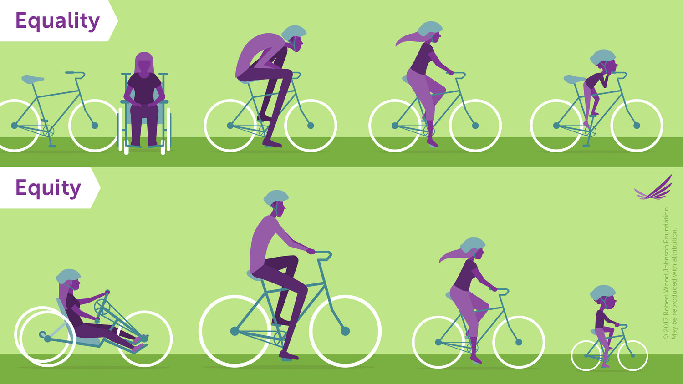
Notes:
Presenter notes:
Explain that the difference between equality and equity is more easily understood with a visual. Equality, as shown, is giving everyone equal rights, opportunities, tools, etc. In this case, a bike.
Equity is recognizing that people have different needs based on historical imbalances based on gender, and that to achieve optimal outcomes, they will need different, tailored approaches that address those imbalances and differences.

Slide 15
Gender norms
Social expectations for what it means to be a boy or a girl
Gender equality
Equal rights, opportunities and choices for boys and girls
Creates a level playing field by addressing historical gender-based imbalances
Gender equity
Notes:
Presenter notes:
Quickly review the terms with the audience.
Option: conduct a rapid quiz by asking audience members to define one of the terms.
Optional talking points:
Gender equality: (e.g., “same bike for all!”)
Gender equity: (e.g., “customized bikes to meet specific needs and abilities because there have been cumulative, historical disadvantages based on gender)
Transition to the next topic of this presentation and explain that now that you have level-set on the terms, it is time to learn more about the problem.

Slide 16
“Very young adolescence [10-14 years old] is a time when young people experience increased pressure to adhere to unequal gender norms that negatively affect their current and future health and well-being…”
Breakthrough ACTION. (2023). Creating a gender-equitable environment for very young adolescents: Messages and evidence to persuade decision makers. Baltimore: Johns Hopkins University. Page 6. https://breakthroughactionandresearch.org/wp-content/uploads/2023/05/Creating-a-Gender-Equitable-Environment-for-VYAs-Messages-and-Evidence.pdf
Notes:
Presenter notes:
Pause and invite the audience to discuss this statement. Ask for examples of norms and how they influence health. Some examples you can refer to are:
Gender norms can influence health behaviors
Gender norms associated with masculinity like strength, toughness, self-reliance, and risk taking lead boys and young men to engage in “excessive alcohol consumption, unprotected sex, dangerous driving or violent practices, and have higher rates of substance abuse, injuries from traffic accidents and homicides.”
“Girls and young women, however, are often seen as more vulnerable and risk-averse and are expected to show modesty, submission and dependence while their movements are restricted and monitored and their sexuality is controlled. As a result, adolescent girls and young women tend to have lower levels of physical activity and are more likely to experience violence or suffer depression.” (ALiGN pg. 6)
Gender norms that influence labor and occupation also influence health
At work, men are more likely to be exposed to noise, vibrations, extreme temperatures, chemicals and be subject to occupational accidents and long-term effects of heavy lifting compared to women
Women tend to be more exposed to “highly repetitive and monotonous work, poor postures, and increased stress and sexual harassment and violence” in the workplace compared to men. (ALiGN pg. 6-7)
Remind the audience that gender norms impact people of all ages. But it is specifically important for VYAs at this critical time in their development.
Explain that research indicates the following (read the quote and emphasize the large, bold points)
Remind the audience that, “Gender norms are those informal expectations that distinguish expected behavior on the basis of gender that are learned and reinforced from childhood to adulthood through observation, instruction, positive and negative sanctioning, the media, religion, and other social institutions. Gender norms are embedded in formal and informal institutions and play a role in shaping women and men’s (often unequal) access to resources and freedoms, thus affecting their voice, power, and sense of self.” (Messaging Framework, page 6).
Restate the key takeaway, which is that gender norms are negatively impacting the health of our young people.

Slide 17
“While intervention during this life stage has great potential to improve young people’s health and wellbeing, there has been
less investment in this age group compared to older adolescents and insufficient focus on boys.”
Creating a gender-equitable environment for very young adolescents, p6
Breakthrough ACTION. (2023). Creating a gender-equitable environment for very young adolescents: Messages and evidence to persuade decision makers. Baltimore: Johns Hopkins University. Page 6. https://breakthroughactionandresearch.org/wp-content/uploads/2023/05/Creating-a-Gender-Equitable-Environment-for-VYAs-Messages-and-Evidence.pdf
Notes:
Presenter notes:
Read the quote and emphasize the large, bold points.
Ask the audience, what does this mean? Explain that, even though we know that gender norms are negatively impacting young people, there really isn’t anything being done about it, and that there has not been enough of a focus on boys.
Pause and let this information sink in.
Explain that next you will go into examples of what this really looks like for very young adolescents 10-14 years of age.

Slide 18
How are very young adolescents (VYAs) doing?
What the research says…
Notes:
Adaptation notes:
The statistics in this adaptable presentation are specific to Indonesia. Here are two studies to consult to find information specific to your context:
The Global Early Adolescent Study (GEAS): Site-specific information is available here, all reports (including site-specific reports) are available here.
The Gender and Adolescence: Global Evidence (GAGE).
Presenter notes:
Should you use information from the GEAS, consider using the following talking points:
Explain that “The Global Early Adolescent Study (GEAS) is a worldwide investigation into how gender norms evolve and inform a spectrum of health outcomes in adolescence. The GEAS seeks to better understand how gender socialization in early adolescence occurs around the world, and how it shapes health and wellness for individuals and their communities.” https://www.geastudy.org/ This is a longitudinal study led by the Johns Hopkins University Bloomberg School of Public Health that provided formative research that inspired the development of this intervention package.
Here is what the GEAS revealed about VYAs in Indonesia, where this package was designed and tested.

Slide 19
INSIGHT
Many adolescents do not feel comfortable talking to their parents or main caregivers about changes occurring during this critical period in their lives where they need trusted adults to guide and support them.
Notes:
Adaptation notes:
These statistics are specific to Indonesia. Here are two studies to consult to find information specific to your context:
The Global Early Adolescent Study (GEAS): Site-specific information is available here, all reports (including site-specific reports) are available here.
The Gender and Adolescence: Global Evidence (GAGE).
Presenter notes:
Clarification point: Adolescents often don’t feel comfortable talking about puberty, relationships, or sexuality
Read the insight or ask a participant to read the insight.
Ask the audience to think about why this matters.
Ask probing questions: If they aren’t talking to their parents or caregivers, who are they talking to? Their peers? Where are they getting their information from? The internet?

Slide 20
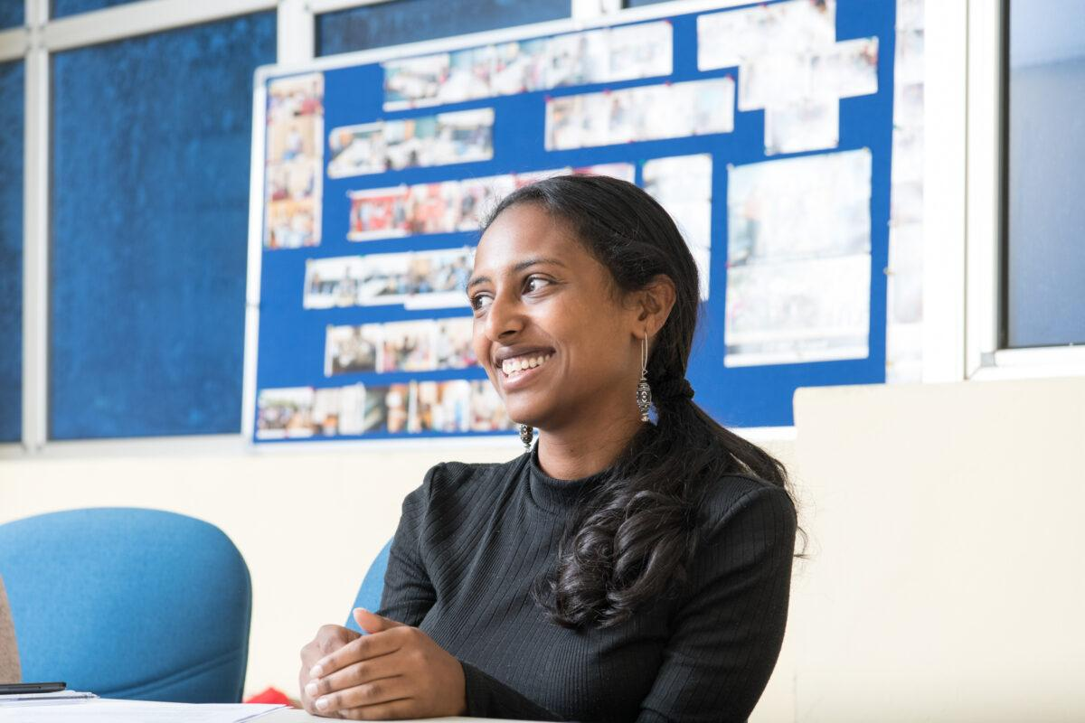
FACT
62%
of adolescents report feeling close to their parents/main caregivers, but only
55%
adolescents feel comfortable talking to them.
Notes:
Adaptation notes:
These statistics are specific to Indonesia. Here are two studies to consult to find information specific to your context:
The Global Early Adolescent Study (GEAS): Site-specific information is available here, all reports (including site-specific reports) are available here.
The Gender and Adolescence: Global Evidence (GAGE).
Consult this free image bank to select images that may resonate more with your audience. https://www.imagesofempowerment.org/
Presenter notes:
Read the insight or ask a participant to read the insight.
Ask the audience to think about why this matters.
Ask probing questions: If they aren’t talking to their parents or caregivers, who are they talking to? Their peers? Where are they getting their information from? The internet?

Slide 21
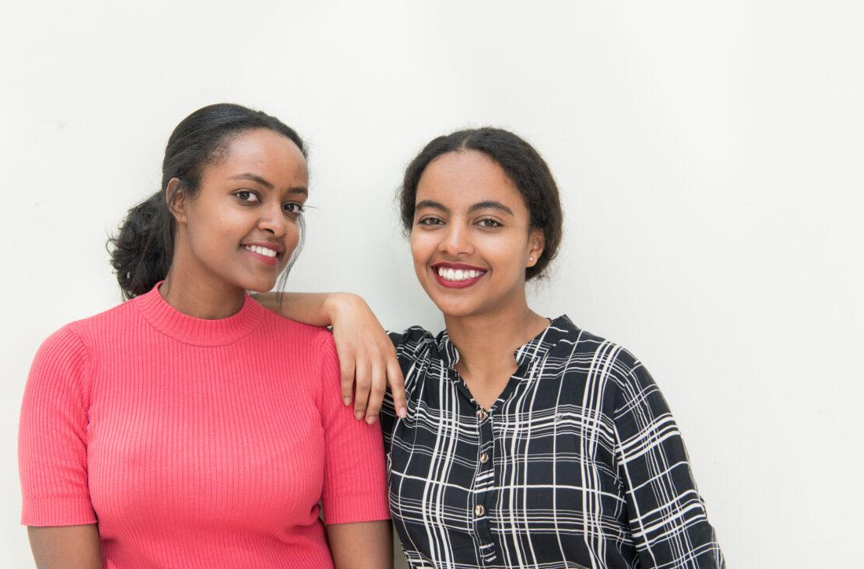
FACT
In terms of choosing who to talk to about their problems,
44% of teenagers chose their mother
33% chose their peers.
Only 3.4% chose their fathers.
Notes:
Adaptation notes:
These statistics are specific to Indonesia. Here are two studies to consult to find information specific to your context:
The Global Early Adolescent Study (GEAS): Site-specific information is available here, all reports (including site-specific reports) are available here.
The Gender and Adolescence: Global Evidence (GAGE).
Consult this free image bank to select images that may resonate more with your audience. https://www.imagesofempowerment.org/
Presenter notes:
Read the insight or ask a participant to read the insight.
Ask the audience to think about why this matters.
Ask probing questions: If they aren’t talking to their parents or caregivers, who are they talking to? Their peers? Where are they getting their information from? The internet?

Slide 22
INSIGHT
In what is supposed to be a safe learning environment, many adolescents feel threatened in schools - both by peers and adults - and do not feel comfortable asking for help. School-based professionals often feel ill-equipped to support students.
Notes:
Adaptation notes:
These statistics are specific to Indonesia. Here are two studies to consult to find information specific to your context:
The Global Early Adolescent Study (GEAS): Site-specific information is available here, all reports (including site-specific reports) are available here.
The Gender and Adolescence: Global Evidence (GAGE).
Note that the original question from the GEAS reads: "Sometimes children feel unsafe or threatened when they are in their neighborhood, on the way to school, or in school. For example, afraid of being attacked, bullied or being hurt. Has this happened to you in the last year?"
Presenter notes:
“Threatened” in this case could mean afraid of being attacked, bullied, or hurt in some way.
Read the insight or ask a participant to read the insight.
Ask the audience to think about why this matters.
Ask probing questions: If they aren’t talking to their parents or caregivers, who are they talking to? Their peers? Where are they getting their information from? The internet?

Slide 23
FACT
18%
of adolescents feel threatened in schools.
7 out of 10 (70.2%)
of those feel threatened by other students at school and 14.9% by teachers/other adults.
4 out of 10 (45.9%) adolescents have witnessed their friends or peers fighting or being bullied.
Notes:
Adaptation notes:
These statistics are specific to Indonesia. Here are two studies to consult to find information specific to your context:
The Global Early Adolescent Study (GEAS): Site-specific information is available here, all reports (including site-specific reports) are available here.
The Gender and Adolescence: Global Evidence (GAGE).
Consult this free image bank to select images that may resonate more with your audience. https://www.imagesofempowerment.org/
Presenter notes:
Read the insight or ask a participant to read the insight.
Ask the audience to think about why this matters.
Ask probing questions: If they aren’t talking to their parents or caregivers, who are they talking to? Their peers? Where are they getting their information from? The internet?

Slide 24
INSIGHT
Adolescents report not just being bullied by their peers but by adults in their lives who are supposed to be guiding and helping them.
Notes:
Adaptation notes:
These statistics are specific to Indonesia. Here are two studies to consult to find information specific to your context:
The Global Early Adolescent Study (GEAS): Site-specific information is available here, all reports (including site-specific reports) are available here.
The Gender and Adolescence: Global Evidence (GAGE).
Presenter notes:
Read the insight or ask a participant to read the insight.
Ask the audience to think about why this matters.
Ask probing questions: If they aren’t talking to their parents or caregivers, who are they talking to? Their peers? Where are they getting their information from? The internet?

Slide 25
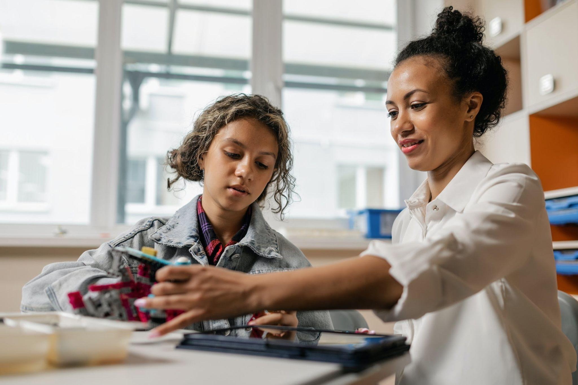
FACT
49.1% of teenagers admit that they have been made fun of in the last six months.
As many as 57.5% of adolescents also admitted that they had received verbal abuse and ridicule from adults.
Half of adolescents feel worried for no apparent reason.
Notes:
Adaptation notes:
These statistics are specific to Indonesia. Here are two studies to consult to find information specific to your context:
The Global Early Adolescent Study (GEAS): Site-specific information is available here, all reports (including site-specific reports) are available here.
The Gender and Adolescence: Global Evidence (GAGE).
Consult this free image bank to select images that may resonate more with your audience. https://www.imagesofempowerment.org/
Note that the GEAS question on teasing victimization does not specify who, but says “someone.”
Presenter notes:
Read the insight or ask a participant to read the insight.
Ask the audience to think about why this matters.
Ask probing questions: If they aren’t talking to their parents or caregivers, who are they talking to? Their peers? Where are they getting their information from? The internet?

Slide 26
INSIGHT
Many adolescents have unequal beliefs about the traits boys and girls should have. These beliefs are taught, not inherent.
Notes:
Adaptation notes:
These statistics are specific to Indonesia. Here are two studies to consult to find information specific to your context:
The Global Early Adolescent Study (GEAS): Site-specific information is available here, all reports (including site-specific reports) are available here.
The Gender and Adolescence: Global Evidence (GAGE).
Presenter notes:
Read the insight or ask a participant to read the insight.
Unequal beliefs about traits refers to boys’ being tough and needing to be strong, while girls should be humble and need protection
Ask the audience to think about why this matters.
Ask probing questions: If they aren’t talking to their parents or caregivers, who are they talking to? Their peers? Where are they getting their information from? The internet?

Slide 27
FACT
Half of boys and one third of girls have unequal beliefs in the traits boys and girls should have.
One third of all adolescents believe in stereotypical roles for girls and boys in their household and communities.
Notes:
Adaptation notes:
These statistics are specific to Indonesia. Here are two studies to consult to find information specific to your context:
The Global Early Adolescent Study (GEAS): Site-specific information is available here, all reports (including site-specific reports) are available here.
The Gender and Adolescence: Global Evidence (GAGE).
Consult this free image bank to select images that may resonate more with your audience. https://www.imagesofempowerment.org/
Presenter notes:
Unequal beliefs about traits refers to boys’ being tough and needing to be strong, while girls should be humble and need protection
Read the insight or ask a participant to read the insight.
Ask the audience to think about why this matters.
Ask probing questions: If they aren’t talking to their parents or caregivers, who are they talking to? Their peers? Where are they getting their information from? The internet?

Slide 28
FACT
Both boys and girls think about or engage in self-harm.
The proportion of boys that think about hurting themselves is
2x that of girls.
Notes:
Adaptation notes:
These statistics are specific to Indonesia. Here are two studies to consult to find information specific to your context:
The Global Early Adolescent Study (GEAS): Site-specific information is available here, all reports (including site-specific reports) are available here.
The Gender and Adolescence: Global Evidence (GAGE).
Consult this free image bank to select images that may resonate more with your audience. https://www.imagesofempowerment.org/
Note that this statistic comes from the GEAS that which has a question in its depression scale that asks for agreement with the statement "I am so unhappy I think of harming myself," as well as the PHQ-9 which asks how often they have had "Thoughts that you would be better off dead or of hurting yourself in some way." As such, harm is not specified.
Presenter notes:
Read the insight or ask a participant to read the insight.
Ask the audience to think about why this matters.
Ask probing questions: If they aren’t talking to their parents or caregivers, who are they talking to? Their peers? Where are they getting their information from? The internet?

Slide 29
[OPTIONAL: TRANSITION SLIDE]
Notes:
Presenter notes:
Optional pause for additional reflection or discussion.
Before transitioning to the next slide, ask the audience a rhetorical question about what can be done about this? What is required?

Slide 30
“Advancing gender equity for VYAs requires a holistic approach to policies and programs that addresses contextual factors, including community- and structural-level factors that affect health.”
Creating a gender-equitable environment for very young adolescents, p6
Notes:
Presenter notes:
Read the quote and emphasize the large, bold points.
Explain that we all have a role to play - as parents, caregivers, professionals, as leaders, across sectors - in the health and wellbeing of young people, and that this is why they are here today.
Explain that contextual factors can include things like access to health services, institutional policies, or social norms related to health.

Slide 31
Creating environments where young people are unconstrained by harmful gender norms can help improve health and well-being of young people.
Notes:
Presenter notes:
Explain that the research says that gender norms can harm VYAs, not just as children but into adulthood. But by creating environments where young people are unconstrained by harmful gender norms, we can help improve health and well-being of young people, which is what we all want for our children - for them to grow up healthy and happy.

Slide 32
How?
Notes:
Presenter notes:
Ask the audience: How can we create more gender-equitable environments in which VYAs can grow and thrive, unconstrained by gender norms?

Slide 33
THEORY OF CHANGE
By addressing gender norms,
Girls/women should remain ‘pure’ and ‘innocent’ (virginity and menstruation)
Girls need their parents protection more than boys (girls are vulnerable and boys are not)
Boys should be tough and not cry or ask for help
It is important for boys to show they are tough even if they are nervous inside
Boys and girls face different expectations for their appearance based on their gender
using proven change mechanisms
1
Role modeling
Diffusing positive social norms
Observed social normative decision making
4
Empathy building
Envisioning alternative futures
Collective reflection and discussion
7
Building cross-sectoral collaboration.
Confronting power imbalances
2
5
8
3
6
throughout a comprehensive intervention package
Multi-Stakeholder Forum
Interactive Video
Exhibition
Safe Schools
Family Space
that spans the VYA environment,
Government institutions
Community leaders
Schools
Families and caregivers
VYAs
Level of the Socio-ecological Model
Intermediate outcomes
Individual
Family, friends and peers
Community
Institutions and policy
we create a more supportive environment for boys and girls that helps improve their health and wellbeing.
Increased knowledge
Increased gender equitable parenting
Positive gender norms
Supportive institutions/systems
Increased agency
Improved & increased caregiver-child communication
Increased community dialogue
Long-term outcomes
Reduced rates of gender-based bullying
Improved mental health
INTRODUCTION
Notes:
Adaptation notes:
The gender norms listed at the top of this slide should be relevant to your context. You can either change them beforehand, or use this as an opportunity to discuss with your audience to learn about what is most relevant to them. Whatever is ideated during this session should eventually be validated amongst VYAs themselves and/or through other existing research, such as the GEAS.
Presenter notes:
Introduce the GET 4 Youth Package - a comprehensive intervention package that helps create a more gender equitable environment for VYAs.
Read through the theory of change on the slide - this is the ultimate value proposition of this package and how it will work.
Explain that it is comprehensive because it:
Reaches key audiences across the very young adolescent environment, including parents and caregivers, school faculty and staff, community leaders, and even the government
Is mutually reinforcing; it provides multiple exposures to those key audiences over a sustained period of time
Explain that you will review the individual interventions in the subsequent slides and show how they work together as a package and what specific challenges they aim to address.

Slide 34
Girls/ women should remain ‘pure’ and ‘innocent’
By addressing gender norms
Girls are vulnerable and boys are not
Boys should be tough and not cry or ask for help
Gendered expectations for appearance

Slide 35
using proven change mechanisms
1
Role modeling
Diffusing positive social norms
Observed social normative decision making
Empathy building
Envisioning alternative futures
Collective reflection and discussion
Building cross-sectoral collaboration
Confronting power imbalances
2
3
4
5
6
7
8

Slide 36
Multi-Stakeholder Forum
throughout a comprehensive intervention package
Exhibition
Interactive Video
Safe Schools
Family Space

Slide 37
that spans the VYA environment
Government departments
Community leaders
Schools
Families and caregivers
VYAs

Slide 38
Level of the Socio-ecological Model
Individual
we create a more supportive environment for boys and girls that helps improve their health and wellbeing.
Increased knowledge
Increased agency
Family, friends and peers
Intermediate outcomes
Increased gender equitable parenting
Improved & increased caregiver-child communication
Community
Positive gender norms
Increased community dialogue
Institutions and policy
Supportive institutions/systems
Reduced rates of gender-based bullying
Improved mental health
Long-term outcomes

Slide 39
Theory of Change
By addressing gender norms,
Girls/women should remain ‘pure’ and ‘innocent’ (virginity and menstruation)
Girls need their parents protection more than boys (girls are vulnerable and boys are not)
Boys should be tough and not cry or ask for help
It is important for boys to show they are tough even if they are nervous inside
Boys and girls face different expectations for their appearance based on their gender
using proven change mechanisms
1
Role modeling
Diffusing positive social norms
Observed social normative decision making
4
Empathy building
Envisioning alternative futures
Collective reflection and discussion
7
Building cross-sectoral collaboration
Confronting power imbalances
2
5
8
3
6
throughout a comprehensive intervention package
Multi-Stakeholder Forum
Interactive Video
Exhibition
Safe Schools
Family Space
that spans the VYA environment,
Government institutions
Community leaders
Schools
Families and caregivers
VYAs
Level of the Socio-ecological Model
Intermediate outcomes
Individual
Family, friends and peers
Community
Institutions and policy
we create a more supportive environment for boys and girls that helps improve their health and wellbeing.
Increased knowledge
Increased gender equitable parenting
Positive gender norms
Supportive institutions/systems
Increased agency
Improved & increased caregiver-child communication
Increased community dialogue
Long-term outcomes
Reduced rates of gender-based bullying
Improved mental health

Slide 40
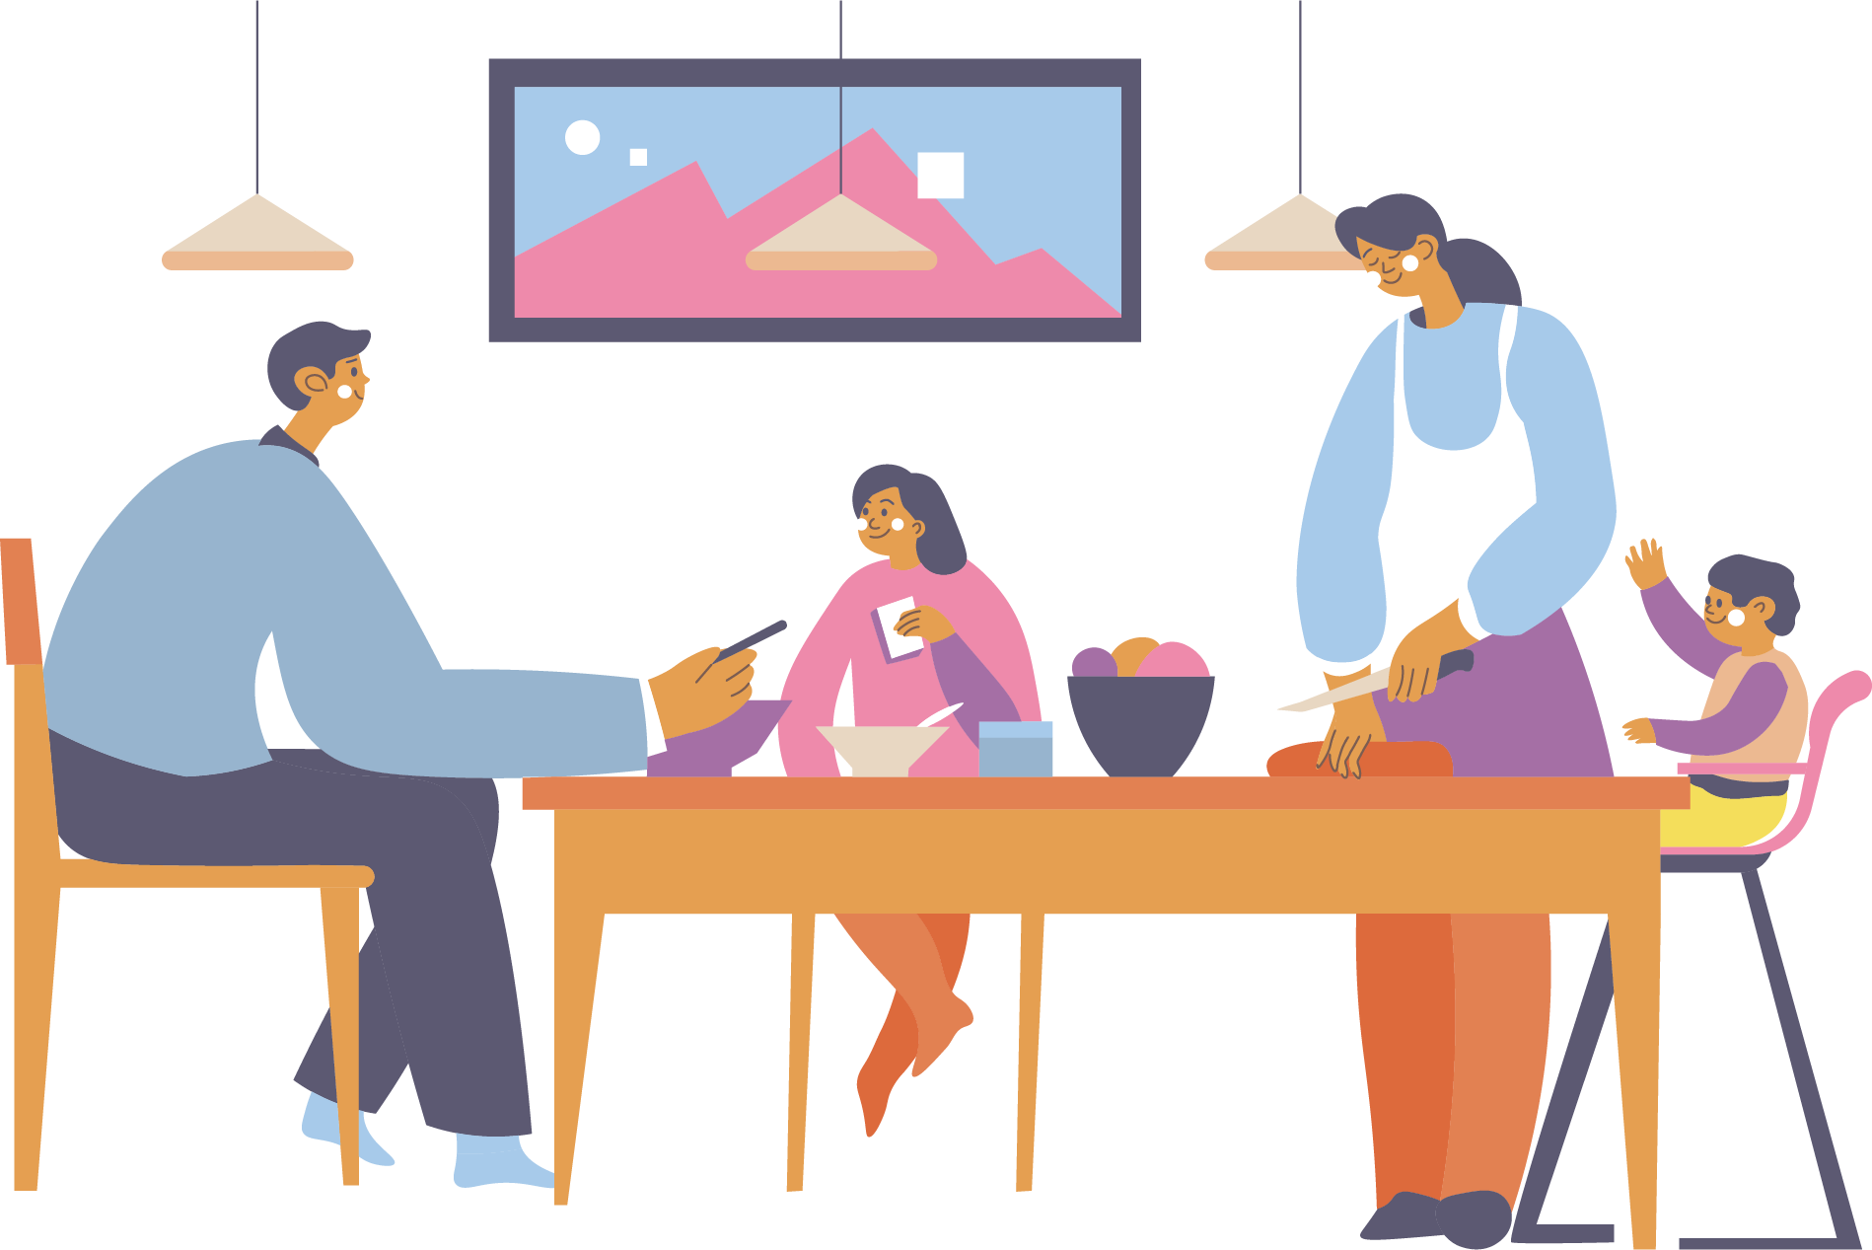
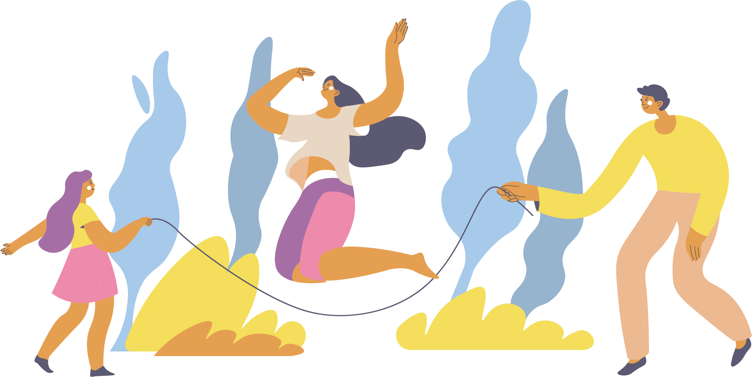
The Gender Equity 4 Youth Package
Goal:
Provide a safe, fun space to strengthen relationships and communication between caregivers and very young adolescents
Goals:
Increase knowledge and empathy about the impact of gender norms, including bullying
Provide a space to release and express emotions related to gender-based bullying
Provide a space for community dialogue about gender norms
Trying to solve:
Providing a more approachable and interactive space for communities to reflect upon and improve gender equity.
Trying to solve:
Many adolescents do not feel comfortable talking to their parents or main caregivers during this critical period in their lives where they need trusted adults to guide and support them.
GET 4 YOUTH PACKAGE
Exhibition
Family Space
Interactive Video
Safe Schools
Multi-stakeholder Forum
Goal:
Spark critical reflection and discussion on how gender norms impact the lives of boys and girls and envision an alternative future
Goals:
Help VYA boys and girls feel comfortable reporting bullying because it will be dealt with fairly
Help school faculty and staff build knowledge and skills to respond to bullying in a gender-equitable way
Trying to solve:
In what is supposed to be a safe learning environment, many adolescents feel threatened in schools - both by peers and adults - and do not feel comfortable asking for help. School-based professionals often feel ill-equipped to support students.
Goal:
Increase prioritization of gender equitable programming
Trying to solve:
Increasing multi-sectoral coordination around gender and youth and to customize piloting and implementation of this package to the local context.
Trying to solve:
Finding creative ways to generate discussion around gender norms.
Notes:
Presenter notes:
This infographic represents the Multi-Stakeholder Forum role as the central nervous system of the intervention package.
This slide helps participants visualize how the package will reach key audiences in their communities.
Parents and caregivers will be reached through the Exhibition and the Family Space
Teachers and school staff will be reached through the Exhibition and through Safe Schools
VYAs will be reached through all three of those (the Exhibition, Safe Schools, and the Family Space)
Community leaders - those present today - help all of this happen through their participation in the Multi-Stakeholder Forum. With their help, together you can create a more gender equitable environment in which very young adolescents can grow and thrive.

Slide 41
Family Space
What is it?
A series of dynamic, activity-based classes for caregivers and VYAs that focuses on strengthening caregiver-VYA relationships and communication.
What makes this unique?
For caregivers AND children.
Highly interactive.
Designed around participant interests.
Allows time for parents to talk to professionals.
Notes:
Presenter notes:
What is it? The Family Space is a series of dynamic, activity-based classes for caregivers and VYAs that focuses on strengthening caregiver-VYA relationships using known change mechanisms: building empathy, envisioning alternative futures, and participating in collective reflection and discussion about gender norms.
Explain that this helps address the need to strengthen caregiver and VYA communication and relationships.
Who is it for? Parents/caregivers and VYAs.
The original idea for this was a parenting class, but it evolved to be something more fun and dynamic and was designed to involve VYAs as well, since there was a need to strengthen bonds and communication. What makes this offering unique is that it:
Is for caregivers AND children. Parenting classes in Denpasar were for parents only, usually mothers. This class creates room for the whole family, as evidenced by the fact that entire families showed up to the high-fidelity test - mothers, fathers, VYAs and siblings.
Is highly interactive. The Family Space is designed to be an engaging environment where families can have fun, build skills, and strengthen bonds. Existing offerings consisted of one-way, lecture-style communication that left parents feeling bored and inadequate.
Reflects participant interests. The Family Space topics were workshopped and refined during co-design sessions and reflect what is important to both VYAs and caregivers.
Allows time for parents to talk to professionals, which is something that caregivers really wanted/

Slide 42
Interactive Video
What is it?
A “choose your own ending” style video stories with 3-5 decision points where viewers select between two options: one that reflects current behaviors and norms, and another that reflects the desired behaviors and more equal norms.
What makes this unique?
Quickly captures audience attention and, through facilitation, sparks critical reflection and discussion
Customizable to different audiences
Notes:
Adaptation note:
Screen the Interactive Video either before or after this presentation and let viewers know that 1) they already experienced one of the interventions, or that they will experience it.
Presenter notes:
What is it? The interactive video is a “choose your own ending” style video story with 3-5 decision points where viewers are encouraged to select between two options: one that reflects current behaviors and norms, and another that reflects the desired behaviors and more equal norms. A facilitated discussion accompanies the video to spark critical reflection and discussion about gender norms and the impact of gender inequity on VYA health and wellbeing.
Who is it for? Community leaders, adults - but can also be adapted to youth and caregivers
Why does this exist? Given the prevalence of short-video style content on the internet, this was suggested as an accessible, entertaining way to engage audiences about gender equity. What makes this offering unique is that it:
Quickly captures audience attention and, through facilitation, sparks critical reflection and discussion
Can be customized to different audiences and settings to increase reach
Should questions arise about what we expect community leaders and adults to do after watching the video, explain that this is intended to be a launching point for understanding and discussion - it helps personalize the issue. Action would be through the Multi-Stakeholder Forum.

Slide 43
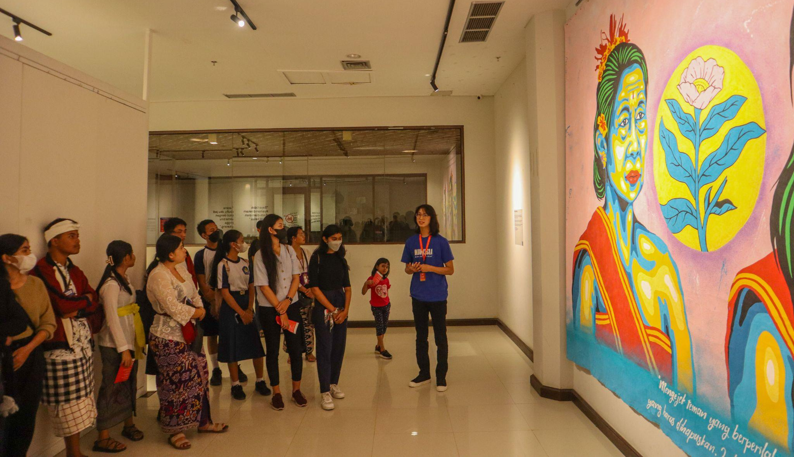
Exhibition
What is it?
An interactive and immersive art experience where adults and VYAs can come to understand and empathize with bullying (specifically gender-based bullying), release and express their emotions through participatory art, and engage in a community dialogue around gender norms.
What makes this unique?
Can reach a large audience
Appeals to families
Novel way to interact with gender content
Emphasizes local ownership, customization and creativity
Attracts organic participation
Notes:
Presenter notes:
What is it? The Exhibition is an interactive and immersive art experience for adults and VYAs alike to understand and empathize with bullying, release and express their emotions through participatory art, and engage in a community dialogue around gender norms. The Exhibition also included a photostory workshop that was held prior to opening that engaged community members in creating one of the stations, as well as a community screening and facilitated discussion of the interactive video.
The Exhibition is curated to highlight the experience and voices of young people. Each installation is developed by an artist that has something to say about gender as it relates to the VYA experience. Even though there isn't a difference in the way that adults and VYAs go through the exhibition, the whole purpose is supposed to elevate the VYA experience. Meant to be taken as a whole - main audiences aren't always VYAs because the package is meant to complement individual level interventions (that are usually for young people). Aim to bridge the gap between young people and the adult influencers in their lives.
Who is it for? Adult community members (caregivers, community leaders, school faculty and staff) and VYAs. The Exhibition is suitable for the general public.
Why does this exist? Multiple ideas for festivals, events or even a museum emerged as a novel way to engage community members in critical reflection and discussion about the harms of gender norms on VYAs. What makes this offering unique is that it:
Can reach a large audience and even appeals to families
Is a completely novel way to interact with gender content
Emphasizes local ownership, customization and creativity
Attracts organic participation

Slide 44
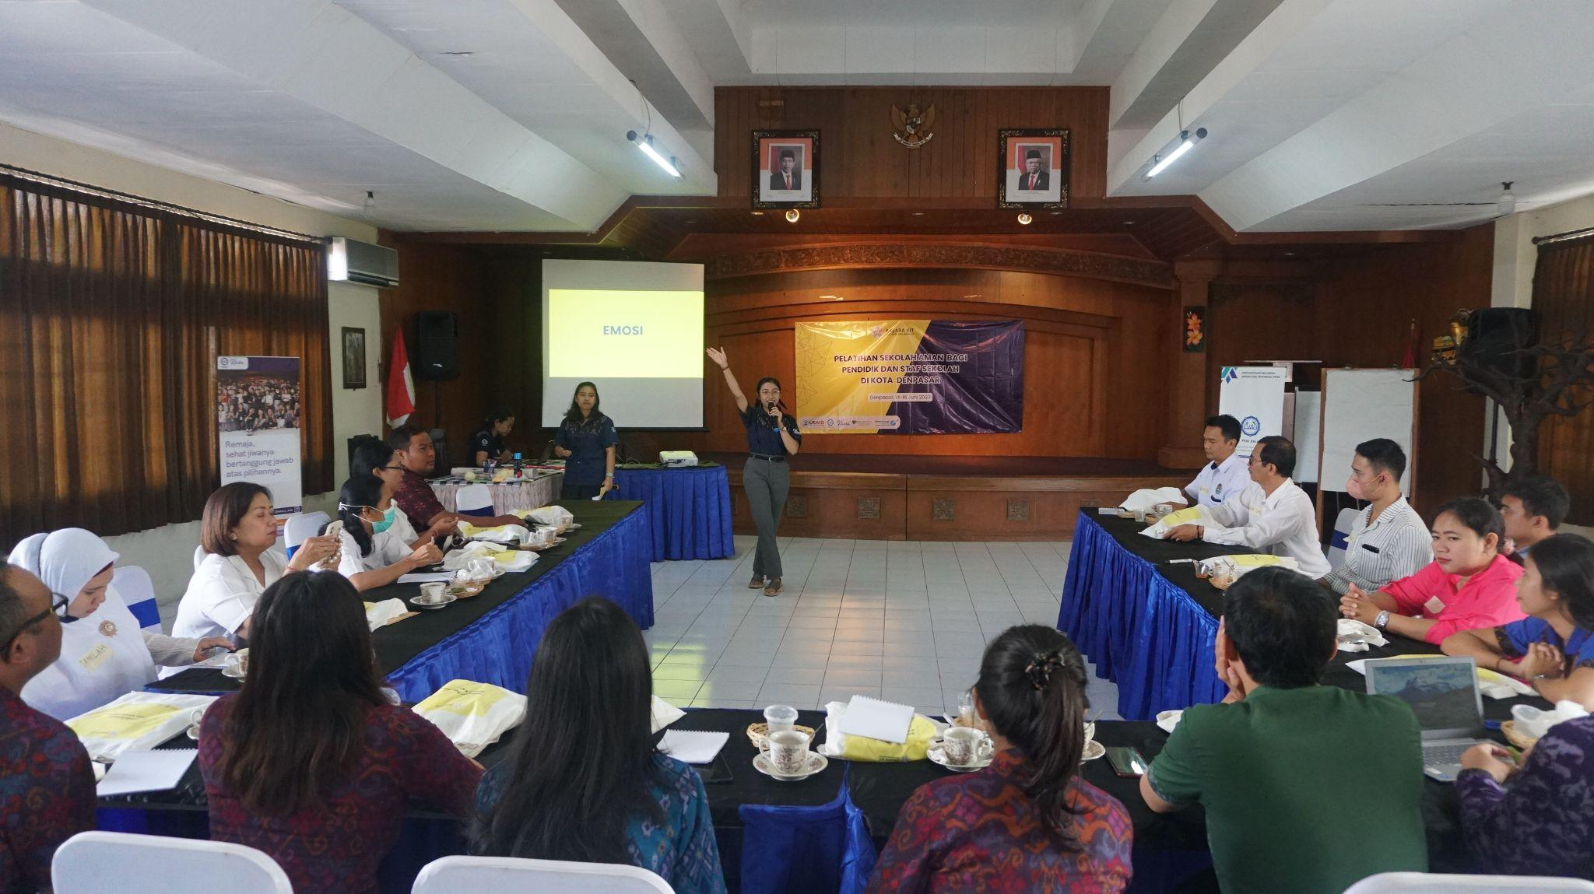
Safe Schools
What is it?
A three-pronged program for middle schools that complements existing bullying prevention programs by equipping schools to respond to bullying in a gender equitable way:
Training
A reporting system
External referral system for complex cases
What makes this unique?
Whole-school approach
Complements existing bullying-prevention interventions
Dynamic, engaging training with new content
Reporting mechanism
Connects schools and community resources
Notes:
Presenter notes:
What is it? Safe Schools is a whole-school program for middle schools that complements existing bullying prevention programs by equipping schools to respond to bullying in a gender equitable way through three main components: Training for faculty and staff, A reporting system for VYAs, and External referral system for complex cases
Why does this exist? Gender-based bullying is a rampant, nearly universal problem among VYAs. While bullying prevention programs exist in Indonesia, they do not address the specific harms of gender-based bullying, and do not leave adults feeling equipped to handle bullying, or address it in a way that does not perpetuate harmful gender norms. What makes this offering unique is that:
It is a whole-school approach, meaning it reaches adults who work at the school - not just teachers, but is intended for anyone at the school who interacts with VYAs - and VYAs themselves.
Complements existing interventions that are focused on bullying prevention by focusing on how to respond to bullying in a way that does not perpetuate gender norms.
The training is dynamic, engaging and contains new, relevant content that interests participants.
Provides a mechanism for VYAs to safely report incidents of bullying in an environment where adults have been properly equipped to handle such incidents.
Makes new connections between schools and existing community resources through the referral system, where previously there was no connection.

Slide 45
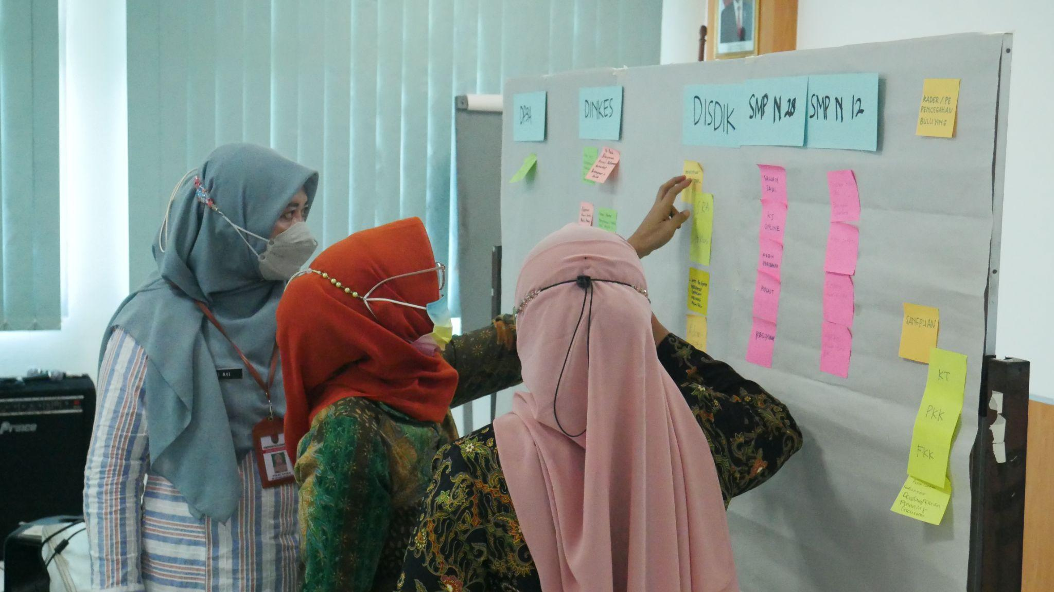
Multi-stakeholder Forum
What is it?
A steering committee style convening of community leaders that aims to localize and customize the package
What makes this unique?
Rejects the “top-down” approach of traditional implementation
Cross-sector collaboration and customization
Notes:
Presenter notes:
What is it? An approach for integrating the prototypes within local programs and initiatives, the Multi-stakeholder Forum is a steering committee-type convening of Village Leaders in Denpasar that aims to increase knowledge and gender-equitable attitudes among community leaders and provide a gateway for package implementation and prioritization of gender equitable programming.
Who is it for? Community leaders across different sectors
Why does this exist? There is a need to establish a shared understanding among community leaders about how gender inequity influences VYA’s health and well-being. This surfaced as a critical initial step in order for community leaders and other government departments to prioritize gender transformative programming. The need for cross-sector collaboration to address that problem also emerged given the various ways and places that gender inequity shows up in communities.

Slide 46
Come to the next meeting
Talk to your colleagues and supervisors about this
Identify existing channels for implementation or integration
Bring your family to the Exhibition
Sign up for the Family Space activity
Notes:
Adaptation notes:
Customize this slide with the “calls to action” that you deem most appropriate for your audience at this time.
Presenter notes:
Explain that you need their help. What
Leave time for questions.

Slide 47
[CALENDAR]
Notes:
Adaptation notes:
Create an event calendar to share with Forum members that contains proposed meeting dates and objectives and includes possible dates for implementing the other interventions

Slide 48
Get in touch!
This report is made possible by the generous support of the American people through the United States Agency for International Development (USAID). The contents are the responsibility of Breakthrough ACTION and do not necessarily reflect the views of USAID or the United States Government.
@[handle]
@
[ADDRESS]
email
Notes:
Adaptation note:
Add your organization’s information to the slide.

Slide 49
Acknowledgements
This presentation is made possible by the generous support of the American people through the United States Agency for International Development (USAID). The contents are the responsibility of Breakthrough ACTION and do not necessarily reflect the views of USAID or the United States Government.
Notes:
Adaptation note:
Add your organization’s information to the slide.

Slide 50
Optional Slides
Notes:
Adaptation notes:
Create an event calendar to share with Forum members that contains proposed meeting dates and objectives and includes possible dates for implementing the other interventions

Slide 51
Process overview
LOW-FIDELITY PROTOTYPING
(Validating Desirability)
MEDIUM FIDELITY PROTOTYPING
(Validating Feasibility)
HIGH FIDELITY PROTOTYPING
(Validating Potential for Scalability)
3
7
11
0
2
CO-DESIGN: IDEA GENERATION
Bring together a diverse range of perspectives, representing the voices of Intent, Experience, Expertise and Design to generate ideas to address the opportunity areas.
CO-DESIGN: ADAPTATION
Conduct a one-day adaptation workshop to validate and identify the key modifications of the prototypes according to contextual relevance.
CO-DESIGN: MODIFY
Facilitate four co-design workshops to validate and identify the key modifications of the prototypes according to contextual relevance.
Set-up the Core-Design Team
IDENTIFY AND PRIORITIZE OPPORTUNITY AREAS
Leverage the findings from quantitative studies conducted by GEAS and identify actionable opportunity areas
4
8
12
REFINE PROTOTYPES
Desk- Research
PRIORITIZE PROTOTYPES FOR DEVELOPMENT
REFINE PROTOTYPES
Refine prototypes to reflect cumulative key learnings from previous testing round(s) and co-design workshops.
1
5
INTENT
TEST THE PROTOTYPES
Undertake an agile process to design and develop working prototypes that are grounded in insight and evidence, including from previous testing rounds, address user needs and meet key design imperatives.
Define the scope and outcome of the project, not the solution. Form the Core Design Team.
See Intent Statement
here
9
TEST THE PROTOTYPES
13
TEST THE PROTOTYPES
Synthesis of quantitative evaluation data, Setara implementation data and qualitative research results (GEAS)
6
EVALUATE & SYNTHESIZE
Analyze the testing results and make recommendations for the next round of testing (or in the case of high-fidelity, what should be included in the pilot package), including which prototypes should be continued, combined, or discontinued.
10
EVALUATE & SYNTHESIZE
14
EVALUATE & SYNTHESIZE
INITIATE GATE Are the project scope, intent and benefits clearly defined?
DESIGN GATE Does the design deliver on the intent?
DESIGN GATE Does the design deliver on the intent?
VIRTUAL
DENPASAR, INDONESIA
SEMARANG, INDONESIA
DENPASAR, INDONESIA
Notes:
Presenter notes:
How was this developed? Breakthrough ACTION led partners and local stakeholders through an HCD process to develop a multi-level package of interventions that reinforce each other and span key audiences across the VYA environment. The team engaged in three design and test sprints across low, medium and high levels of fidelity, testing different components of each prototype and validating and strengthening other aspects.
Breakthrough ACTION’s social and behavior change design process integrates research, behavioral sciences, human-centered design, communication, and community capacity strengthening into a cohesive, flexible approach. The methodology centers around divergence and convergence: a broad exploration of possibilities, then decisive action about which to execute. The process requires getting visual and tangible as quickly as possible to externalize ideas, accelerate collaboration, iterate through possible solutions and scenarios, to quickly learn what is desirable (through a low-fidelity test), what is feasible (through a medium-fidelity test), and what is scalable (through a high-fidelity test).
The diagram illustrates the process that the core design team underwent over the course of a year.
0. Synthesis of quantitative evaluation data, Setara implementation data and qualitative research results (GEAS)
Define the scope and outcome of the project, not the solution. Form the Core Design Team.
Leverage the findings from quantitative studies conducted by GEAS and identify actionable opportunity areas
Bring together a diverse range of perspectives, representing the voices of Intent, Experience, Expertise and Design, to generate ideas for how promote a gender equitable environment for VYAs.
Make decisions as a team to prioritize the emerging concepts for development and testing.
Document the proposed interventions to take on to adaptation in other countries/contexts.
Undertake an agile process to design and develop working prototypes that are grounded in insight and evidence, and addresses key user needs.
Facilitate adaptation workshops to validate identify the key modifications of the interventions according to contextual relevance.
Facilitate co-design workshops to ideate and validate the key modifications of the interventions according to contextual relevance.
Refine prototypes to reflect cumulative key learnings from 2 rounds of testing and 2 rounds of co-design.
Project Partners
The following partners comprise the project team that worked together across to co-design, test and refine the package of solutions:
CCP: The Johns Hopkins Center for Communication Programs, the Breakthrough ACTION consortium lead.
GEAS: The Global Early Adolescent Study, of which Johns Hopkins Bloomberg School of Public Health is a lead partner. GEAS evaluated the Setara program that this design challenge aims to complement.
PKBI Bali: The local implementing partner subcontracted by CCP. PKBI Bali was also the local implementing partner for the Setara program, and is well-known in Denpasar for its KISARA program that trains 10-24 year old volunteers who study SRH issues to be young facilitators, educators, advocates and counselors.
ThinkPlace: The human-centered design (HCD) lead for Breakthrough ACTION.

Slide 52
THEORY OF CHANGE continued
Level of the Socio-ecological Model
This graphic illustrates how the interventions drive specific intermediate outcomes.
Individual
Family, friends and peers
Community
Institutions and policy
Interventions
Intermediate outcomes
Long-term outcomes
Enabling environment for gender equality
Increased knowledge of gender, gender norms, and how they impact VYAs
Increased gender-equitable attitudes
Positive norms supportive of gender equality
Increased prioritization/ agreement at the institutional level of the urgency to address gender inequity for VYAs
Increased multi sectoral coordination around gender and youth
Multi-stakeholder Forum
Community Leaders
Interactive Video
Increased community dialogue and reflection on gender and gender norms
Reduced rates of gender-based bullying
Community Leaders
Teachers, School Staff
Exhibition
Improve empathetic relationships between VYAs and adults
VYAs
Community Members
Improved mental health
Safe Schools
Increased and more equal agency of boys and girls’ to ask adults for help
Improved actions taken at schools to address bullying (specifically gender- based bullying) following an established system
Bullying is handled in a gender equitable way (boys aren’t dismissed/ discouraged from reporting)
VYAs
Teachers, School Staff
Family Space
Improved and increased caregiver-child communication
Caregivers practice gender equitable parenting
VYAs
Parents / Caregivers
INTRODUCTION

