Slide 1
Day 1 Overview
Notes:
This resource is part of the Malaria SBC Strategy Development Toolkit

Slide 2
Stakeholder workshop goals are to answer:
Where are we?
Where do we want to go?
How did we get here?
How will we know if we are getting where we want to go?
How will we know when we are there?
Notes:
Facilitator note: these questions will frame the strategy development process. Refer to the stakeholder agendas (days 1-3) for the outputs of each section (a well as links to corresponding resources)

Slide 3
Strategic Plan Objectives
Goal:
Objectives:
Notes:
Facilitator note: these should come directly from the National Strategic Plan. The purpose of this slide is to emphasize that the malaria SBC strategy’s purpose is to accomplish the broader NSP goals and objectives.

Slide 4
Guiding principles
Evidence-based decision making
The plural of anecdote is not data: no storytelling
Best practices
Quality SBC is a process: cut no corners
Focused programming
Focus demands sacrifice: a little of everything accomplishes nothing
Notes:
Facilitator note: refer to the P-Process as an example of an SBC process https://www.thecompassforsbc.org/sbcc-tools/p-process
Focus demands sacrifice: a malaria SBC strategy that contains a list of every possible behavior, with activities to address every single behavioral determinant, is not likely to succeed in resource-limited environments. More importantly, audiences will not respond to too many messages: sacrificing the number of messages conveyed will achieve better recall

Slide 5
Stakeholder workshop timeline
Day 1
Day 2
Day 3
Where are we now and how did we get here?
Review and interpret data to develop situation analyses
Where do we want to go?
Articulate shared vision and
How will we get there?
Conduct root cause analysis to prioritize behaviors
How will we get there (continued)
Use root cause analyses to develop audience analyses and strategic communication approaches
Use root cause analyses to draft communication objectives (time permitting)
How will we know if we are getting where we want to go and how will we know when we are there?
Develop a monitoring and evaluation plan
Notes:
Facilitator’s note: refer to the accompanying stakeholder agendas (days 1-3) as well as the stakeholder terms of reference template

Slide 6
Workshop Outputs: day 1
Where are we now (and how did we get here)?
Output: situation analysis
Where do we want to go?
Output: shared vision
How do we get there?
Output: root cause analysis
Notes:
Facilitator notes: refer to strategy template guidance for sample situation analysis content. The following how-to resource may be helpful: https://www.thecompassforsbc.org/how-to-guides/how-conduct-situation-analysis

Slide 7
Workshop Outputs: day 2
Whose behaviors need to change and who influences their decision making?
Output: audience analysis and strategic communication approaches
How will we change prioritized behaviors?
Output: communication objectives
Notes:
Facilitator notes: refer to the strategy template guidance for examples of audience analyses and strategic communication approaches.

Slide 8
Workshop Outputs: day 3
What goes into a behavior-specific plan?
Output: target audiences, objectives, key promises, supporting points, strategic approaches
What practical considerations will make implementation effective?
Output: distillation of NMCP and partner experiences and articulated considerations for areas of different transmission (where applicable)
How will we know if we are getting where we want to go and how will we know when we get there?
Output: monitoring, evaluation, and learning plan
Notes:
Facilitator notes: refer to the strategy template guidance for examples of behavior-specific communication plans

Slide 9
Reviewing the Data

Slide 10
Description of trends
Where were we in beginning of last strategy?
Where are we now?
Notes:
Facilitator notes: a description of trends will inform a draft of the strategy’s background section. These details are often captured in national malaria control program performance reviews. This slide should cover general malaria achievements and trends: SBC-specific content will come afterwards.

Slide 11
How did we get here?
Potential explanations for trends – socioeconomic changes, commodities, policies, media environment etc.
Notes:
Facilitator notes: still focus on general changes

Slide 12
SBC Programming
What SBC efforts were made in your thematic area over this time period?
Notes:
Facilitator notes: discuss SBC-specific changes and trends. It may be helpful to refer to the previous malaria SBC strategy introduction and background sections.

Slide 13
What don’t we know?
Incomplete or missing data
Potential opportunities for data collection
Exciting idea: What have you been interested in and would like to try, if given the chance?
Focus on data collection, measurement or data use

Slide 14
Notes:
Facilitator notes: the following slides will help develop a shared vision, the output of which will be the strategy’s introduction (often signed by a program director or a minister of health). This should capture a country’s specific vision (which may articulate global strategy goals in a country’s context). Note that one of the key objectives of a stakeholder workshop is to obtain stakeholder buy-in, and that developing a truly shared vision establishes this buy-in.

Slide 15
Shared Vision

Slide 16
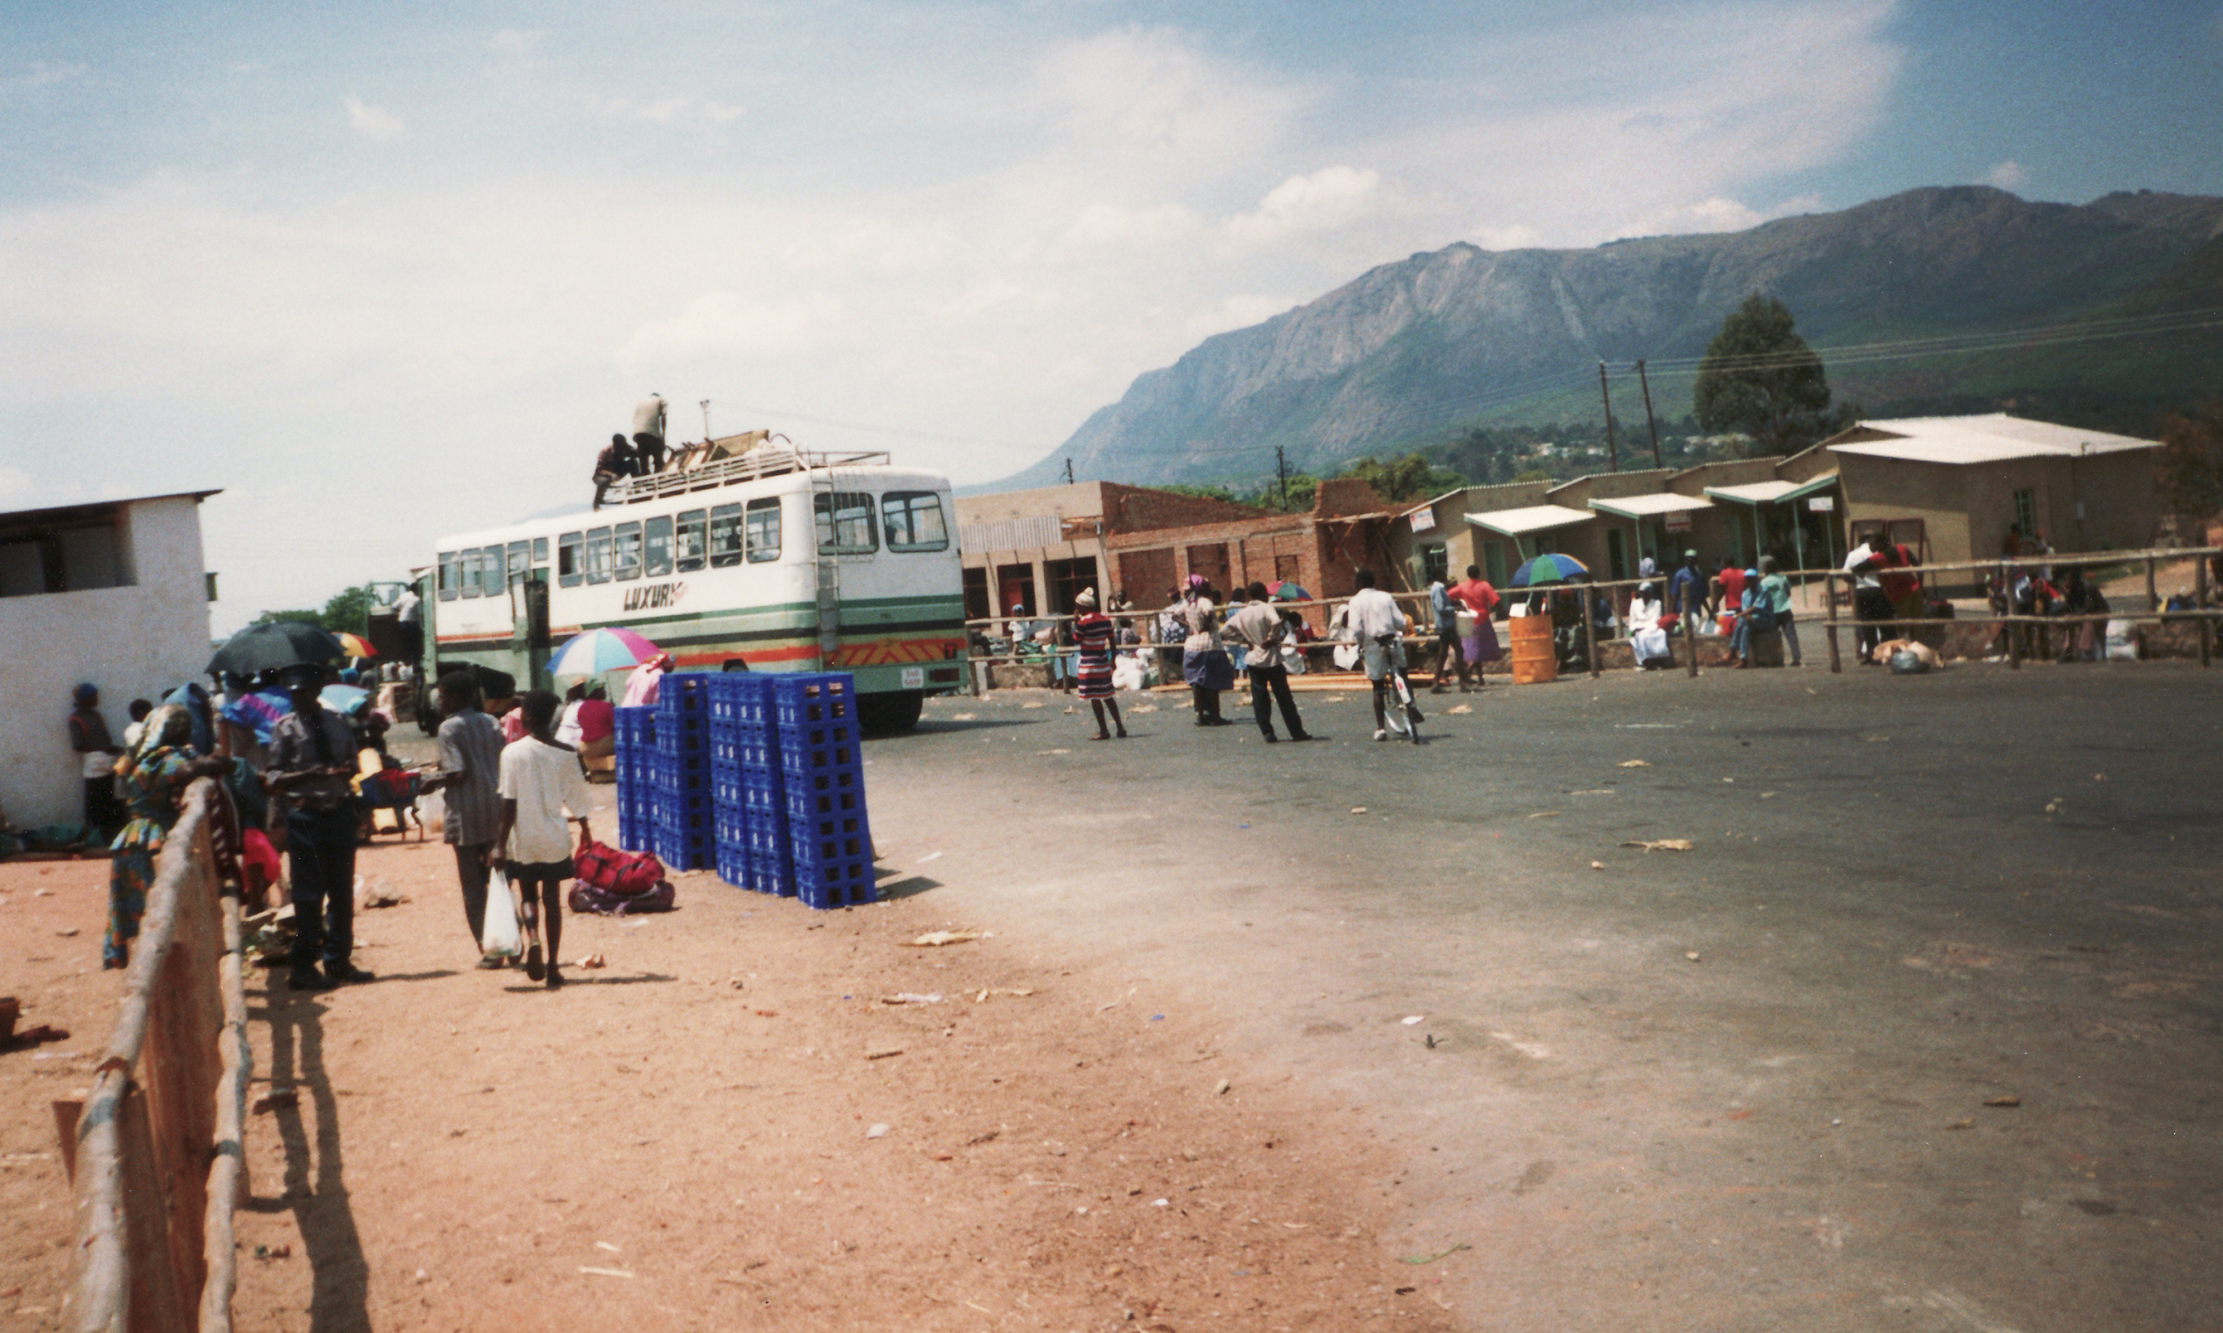
A Day in the Life
(update for your country)
Notes:
The year is 2022. Zimbabwe’s NMCP has achieved unprecedented gains in the fight against malaria, becoming the highest achieving national program among the Elimination 8 block’s first line countries. A recent malaria program review found innovations in SBC responsible for unprecedented increases in LLIN use, IPTp uptake, and care seeking for fever. Roll Back Malaria’s Progress and Impact Series has recently featured Zimbabwe’s innovations in SBC, catching global attention. An official from the WHO and a reporter from the The Herald are accompanying you on a field visit to a rural community just outside Nyanga in Manicaland. You have spent most of the ride making small talk and trying to think of how best to describe your success in a way they will understand. You’re not sure they know much about malaria or communication. Sitting in your car, waiting for your driver to refill at a petrol station in Nyanga before continuing on, an idea hits you! You begin explaining what steps led your SBC program to such incredible success.

Slide 17
Shared Vision
A shared vision statement:
Clarifies what is important
Illustrates what you want to happen in the future
Guides the strategy design and development process

Slide 18
Example vision statement: Zimbabwe
“To have a malaria free Zimbabwe through empowered communities who have the knowledge and skills to protect themselves from malaria.”

Slide 19
Example vision statement: Liberia
“The vision of the Liberia malaria program is a healthier Liberia with universal access to high quality malaria interventions with no malaria deaths”

Slide 20
Instructions
Individually write down: “It’s 2022 and malaria SBC has been wildly successful.” What does success in malaria communication looks like to you?
Then in groups, share your statements, then nominate two statements that you like the best. Feel free to adapt statements shared by your group members.

Slide 21
Instructions (part 2)
Participants get up and put a sticker on elements that they liked.
Discussion questions:
Why did you choose these elements?
What does success look like at the household level, community level, district or province level or national-level?
Notes:
Facilitators note: capture ideas in this session and use this content to complete the introduction during small group work in the writing retreat (see writing retreat agendas and resources)

Slide 22
for what only appears in the roots.” -Rumi
“Maybe you are searching among the branches
Notes:
Facilitators note: Many malaria SBC strategies have made the mistake of focusing solely on behaviors, without using data to describe determinants of behavior and specific approaches tailored to address those determinants. These slides illustrate the importance of a strategy that focuses on addressing specific behavioral determinants.

Slide 23
Root Cause Analysis
Notes:
Facilitators note: consider using the following resource: https://www.thecompassforsbc.org/how-to-guides/how-conduct-root-cause-analysis

Slide 24
Causal Factors and the Root Cause
What sequence of event leads to the problem?
What conditions allow the problem to occur?
What problems co-exist with the root cause contribute to it?
Notes:
Facilitator’s note:
Causal factor: this factor contributes to the problem but may not be root cause (most important) and may not be something SBC can address
Root cause: this is the factor or factors underlying a complex problem. The root cause in this exercise should be a factor that SBC can address.

Slide 25
Root cause analysis objectives
Know the difference between causal factors and the root cause of a problem
Identify causal factors of a public health problem (issues that contribute to the problem in general)
Identify root causes of a public health problem (both program and communication challenges)
Identify and rank SBC challenges (those changes we can solve through SBC)

Slide 26
Malaria in Pregnancy
Apparent Problem
Notes:
Facilitator’s note: use the following sequence of slides to clarify the differences between problems SBC can solve, and larger issues that must be addressed with other approaches. This exercise will ensure the malaria SBC strategy prioritizes only those behaviors, and determinants of behavior, that SBC can improve.

Slide 27
Malaria in Pregnancy
Apparent Problem
Low IPTp Uptake
Untreated fever
Symptoms of problem
(causal factors)

Slide 28
Malaria in Pregnancy
Apparent Problem
Low IPTp Uptake
Untreated fever
Symptoms of problem
(causal factors)
Late booking for first ANC
Facility SP stock-outs
Low perceived risk
Distance from facility
Possible root causes

Slide 29
Malaria in Pregnancy
Apparent Problem
Low IPTp Uptake
Untreated fever
Symptoms of problem
(causal factors)
Late booking for first ANC
Facility SP stock-outs
Low perceived risk
Distance from facility
Possible root causes
Reluctance to disclose pregnancy
Supply chain issues
Association with fever and pregnancy
Financial burden of transport
Possible root causes

Slide 30
Malaria in Pregnancy
Apparent Problem
Low IPTp Uptake
Untreated fever
Symptoms of problem
(causal factors)
Late booking for first ANC
Facility SP stock-outs
Low perceived risk
Distance from facility
Possible root causes
Reluctance to disclose pregnancy
Supply chain issues
Association with fever and pregnancy
Financial burden of transport
Possible root causes
Cultural norms
Actual root cause

Slide 31
Malaria in Pregnancy
Apparent Problem
Low IPTp Uptake
Untreated fever
Symptoms of problem
(causal factors)
Late booking for first ANC
Facility SP stock-outs
Low perceived risk
Distance from facility
Possible root causes
Reluctance to disclose pregnancy
Supply chain issues
Association with fever and pregnancy
Financial burden of transport
Possible root causes
Cultural norms
Actual root cause

Slide 32
Prioritize SBC Challenges
Consider:
The potential impact of addressing the SBC challenge
The greater the potential impact, the more important it is to address
How difficult it will be to reach the audience associated with the SBC challenge?
Whether there is a logical order in which to address the SBC challenges.
If more than one causal factor is linked to the root cause. When a root cause is the source of multiple causal factors, it indicates that addressing the root cause can have far-reaching effects.

Slide 33
Instructions
Use one problem at the top of a piece of paper (use as many pieces of paper as you have problems)
List causal factors of that problem beneath it, drawing lines from the causal factors up to your problem
List possible root causes beneath each causal factor, drawing lines from the possible root causes up to the causal factors
Be on the lookout for root causes that cause multiple issues, these are particularly important
Notes:
Facilitator’s note: The output of this exercise will be a draft situation analysis for malaria in pregnancy, vector control, and malaria case management. Refer to the tell-a-story with data worksheets and the strategy template guidance

